Slide 1



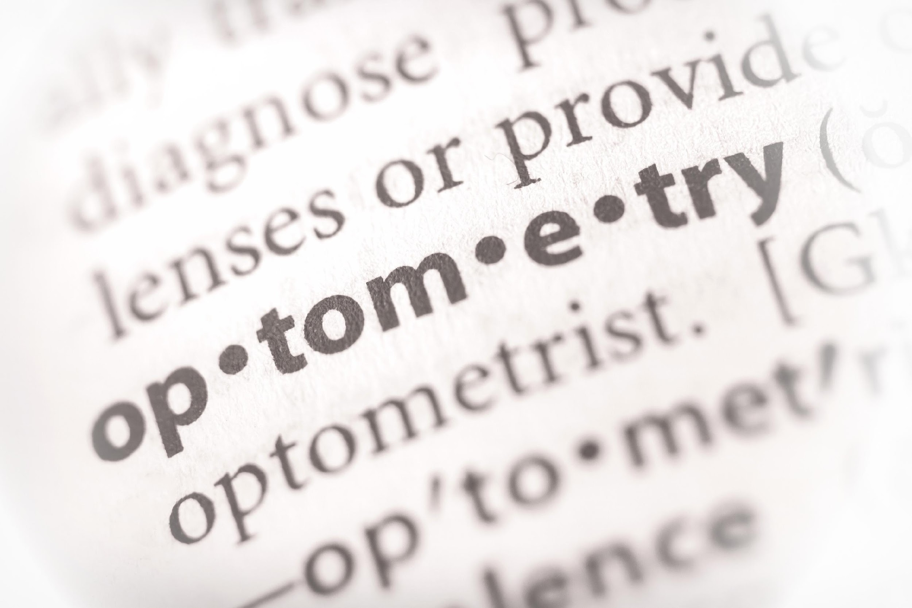





UH Pre-Optometry Professional Society
Fall 2024
3rd General Meeting
10/16/2024

Slide 2





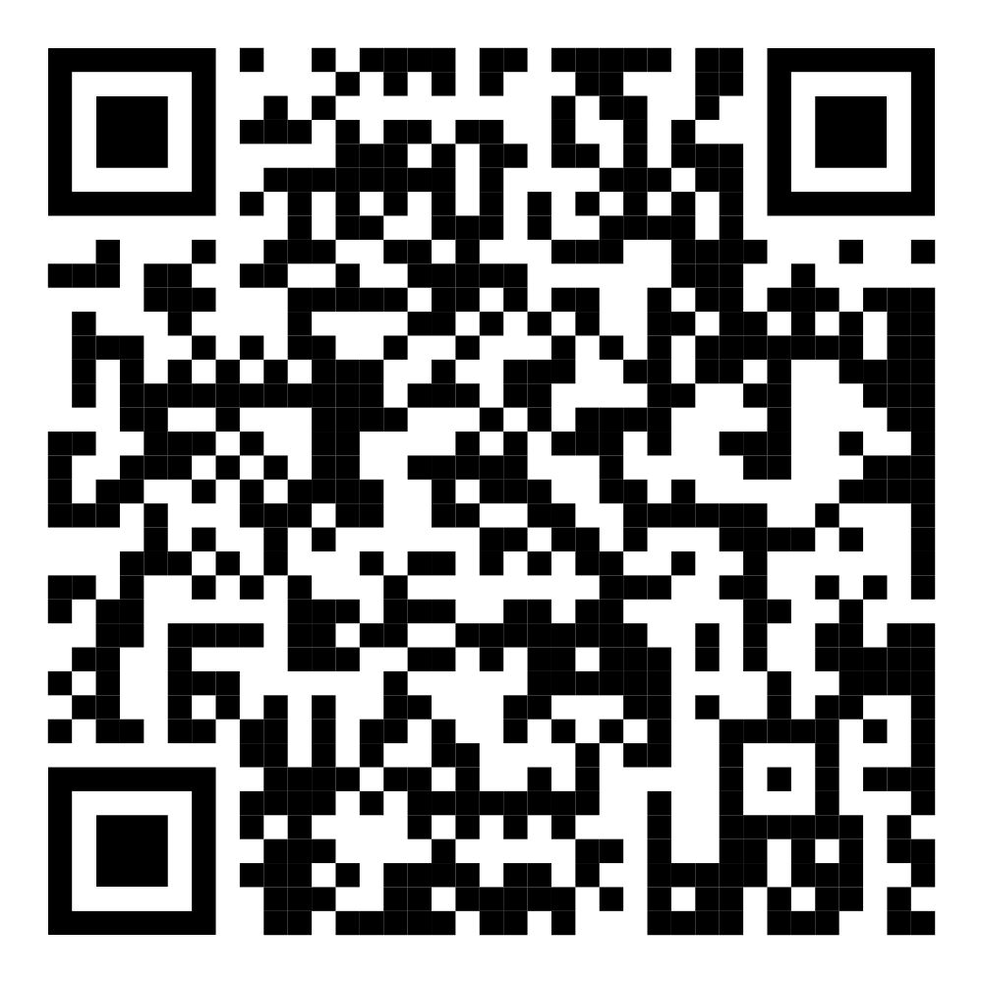

Sign-In
  Scan the QR Code and fill out the google form to earn points for attending!
        The password is case sensitive
        Password: POPSicles!
  If you are having any issues, please send an email to uhpops.secretary@gmail.com before the meeting ends.

Slide 3



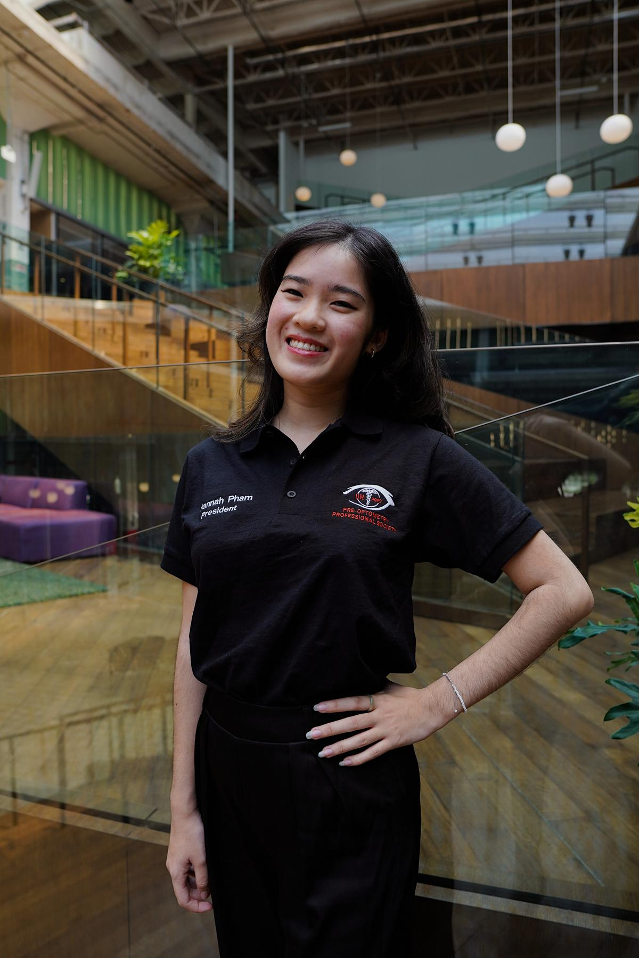

President
Hannah Pham
Email:
uhpops.president@gmail.com
Carrel Space:
SC North, Carrel 37
Office Hours:
Monday, 11:00AM - 12:00PM

Slide 4
Duties
  Preside at all General Meetings and Officer Meetings
  Create and provide information necessary for POPS members
  Conduct elections during the Spring semester
  To be familiar with the Constitution of POPS
  As being the highest status within POPS, will provide final decision on all matters of the student organization
  Plan TOA
  Submit event details to Public Relations, Historian, and Webmaster for posting on social media and the website

Slide 5
Duties
  Update events and officer information
  Order POPS member shirts and officer polos
  Maintain professional communication with important contacts (admissions representatives, faculty, and doctors)
  Check the POPS mailbox at the Student Organization Center in Student Center North
  Maintain the uhpops.president@gmail.com & uhpops@gmail.com emails

Slide 6



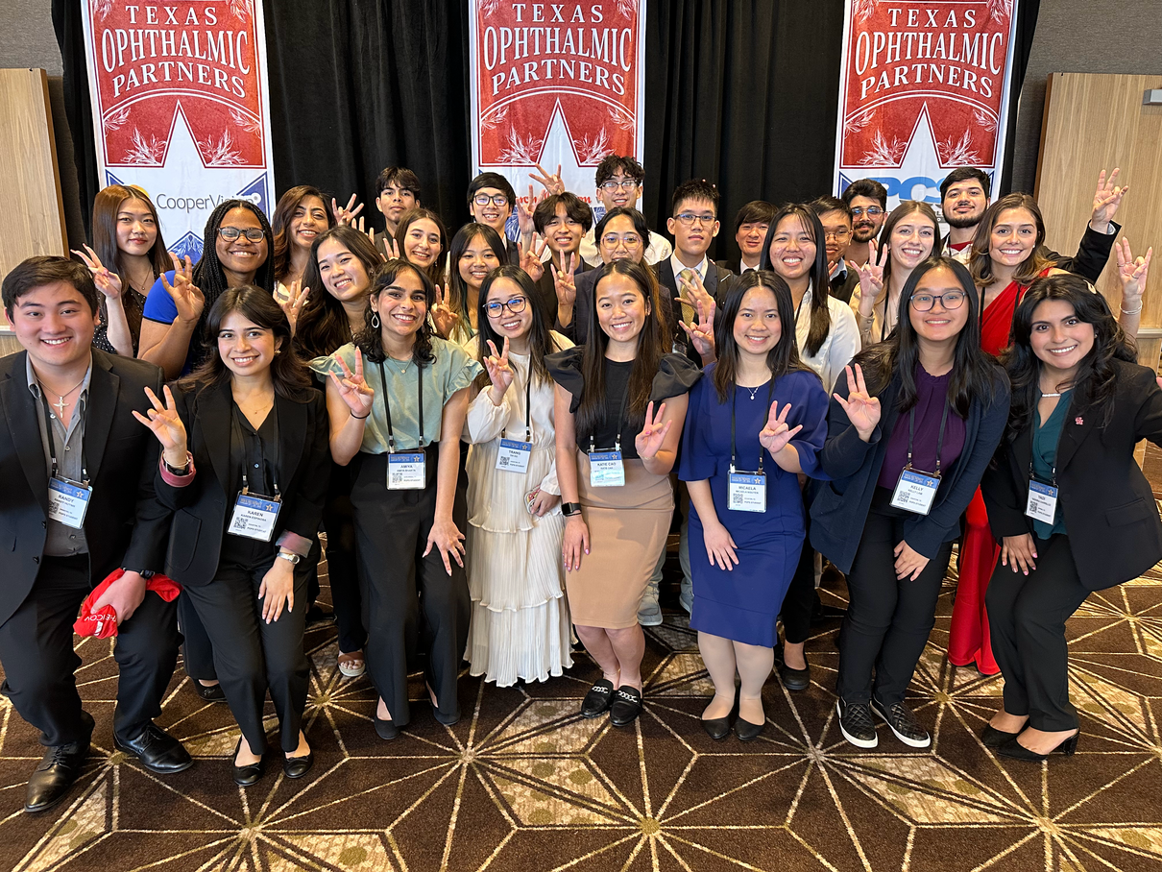
Member Benefits
Membership Opportunities
  Connect and network with fellow pre-optometry students
  Discover classmates to form study groups
  Engage with families within POPS and participate in monthly social events
  Take advantage of semester scholarships and discount codes
Optometric Opportunities
  Direct interaction with UHCO advisors
  Guest speakers from diverse optometry schools
  Volunteering opportunities within the field of optometry
  Jobs and shadowing opportunities
  Engagement with optometry at significant events
  OAT Resources/Study Materials

Slide 7







Fall General Meetings
  9/11 | 6:30 PM-8:30 PM - Meeting with UIW
  9/25 | 6:30 PM:-8:30 PM - Guest Speaker: Dr. Brunstetter
  10/16 | 6:30 PM-8:30 PM - Guest Speaker: Dr. Moore
  10/23 | 6:30 PM-8:30 PM - Guest Speaker: Dr. Sapoznik
  11/13 | 6:30 PM-8:30 PM - UHCO AOSA
Notes:
Dr. Sapoznik

Slide 8
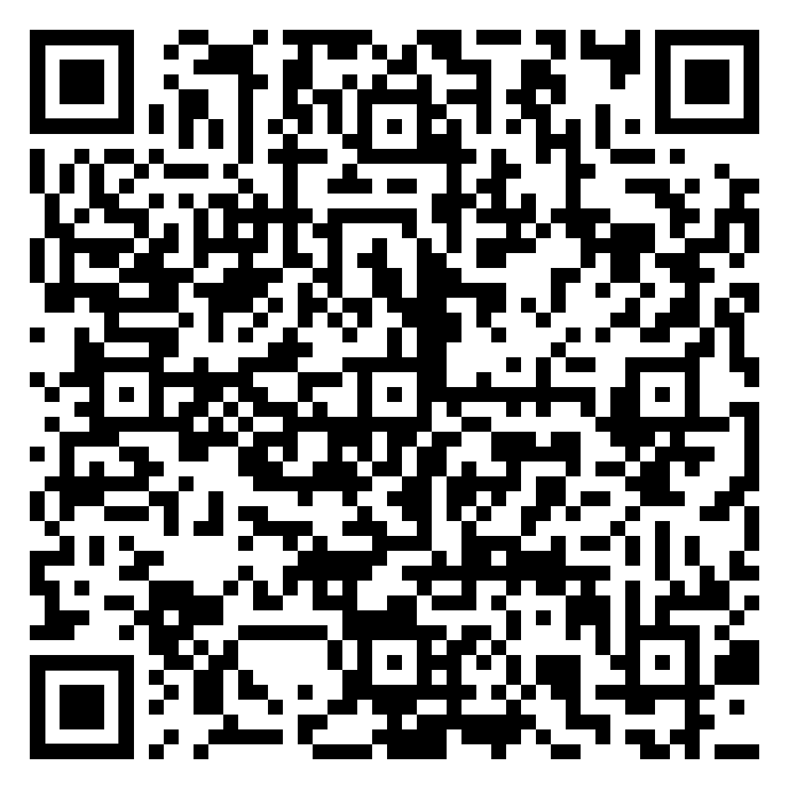
UIW Preview Day
  Learn about the student life experience with current RSO students
  Interact with RSO faculty and tour their facilities
    September 28th, 2024
      9725 Datapoint San Antonio, TX 78229
        9:00 am - 1:00 pm

Slide 9
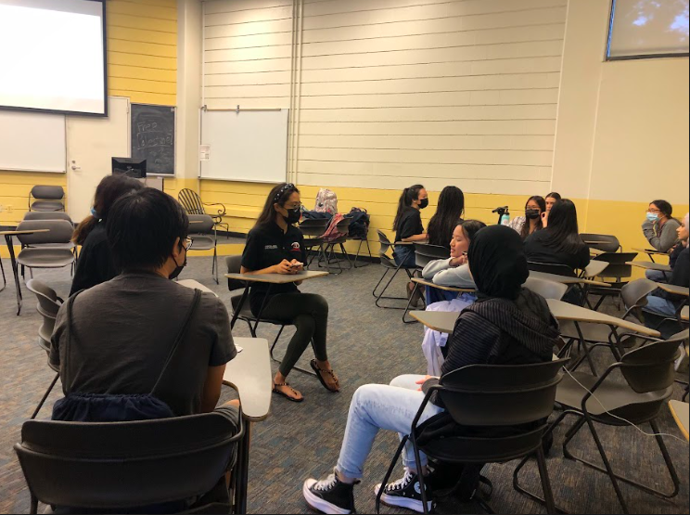
Undergraduate Advice Workshop
  Thursday October 3rd
  Location CBB 122
    Come and get advice from our officers about everything from classes, working, and how to balance extracurriculars

Slide 10
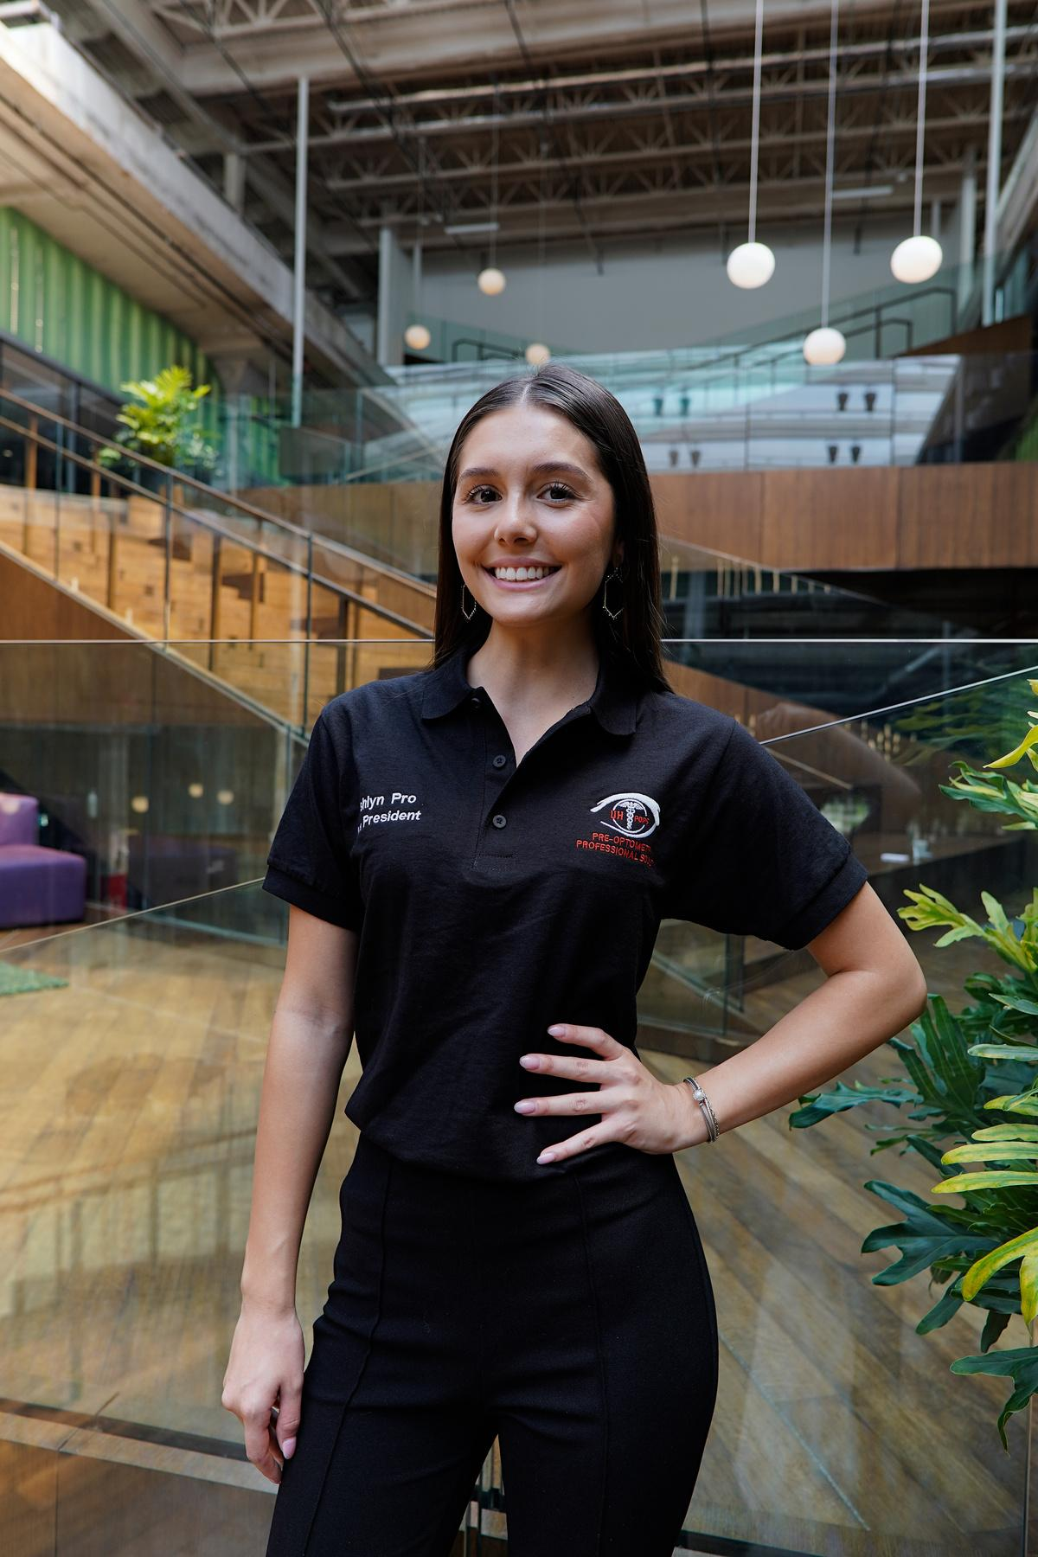
Vice President
Ashlyn Pro
Email:
uhpops.vp@gmail.com
Carrel Space:
SC North, Carrel 37
Office Hours:
Tuesday, 10:00AM - 11:00AM

Slide 11


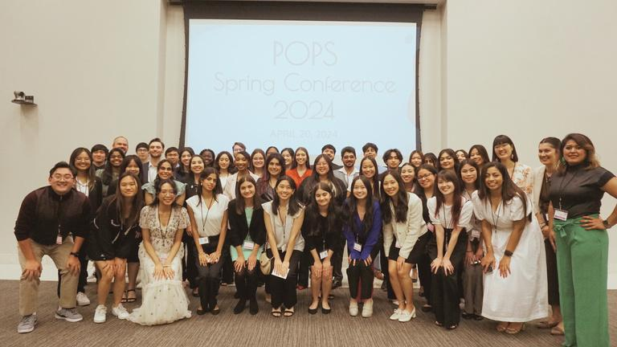



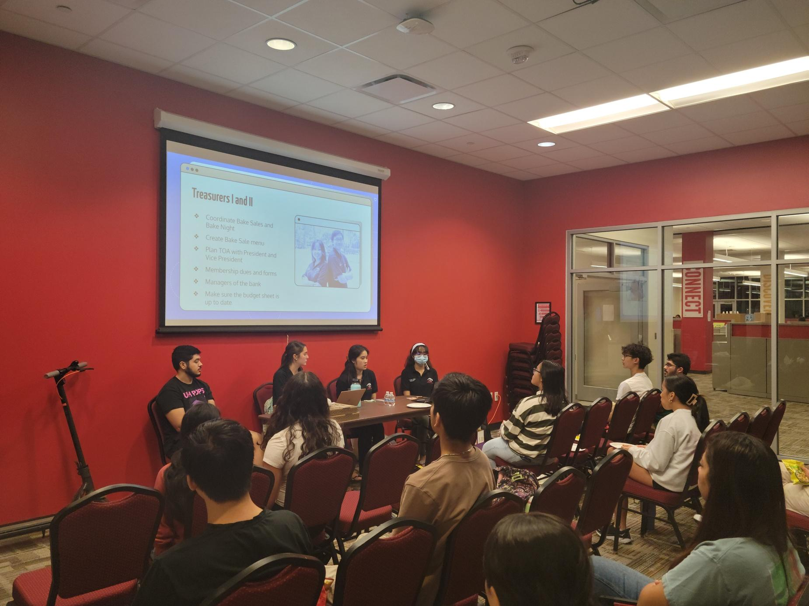

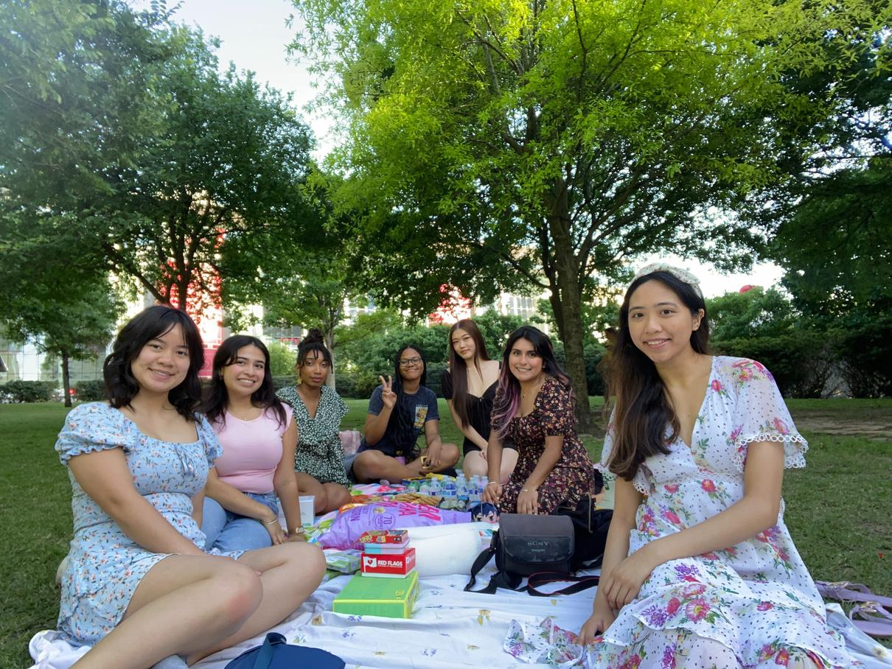
Duties
- Opportunities for Research, Shadowing, and Internships
- Scholarships
- Organizing Social Events
- Spring Conference
- Supporting the President

Slide 12


Fall Semester Scholarship!!
  Deadline
    November 6th at 11:59 PM
    No Late Entries
  Prizes
    1st place - $150
    2nd palace - $100
    3rd place - $50
  Requirements
    50 points by the deadline
    Must be a PAID POPS member
  Essay topics
    What does serving the community mean to you?
    Why do you aspire to be a doctor?
    How has optometry changed your life?
  Outline
    Submit your essay as a PDF / Word doc
    1 page minimum / 1.5 page maximum
    12 pt font size (Arial or times new roman)
    Single-line spacing
    Must include prompt in the title
send your essay to uhpops.vp@gmail.com

Slide 13
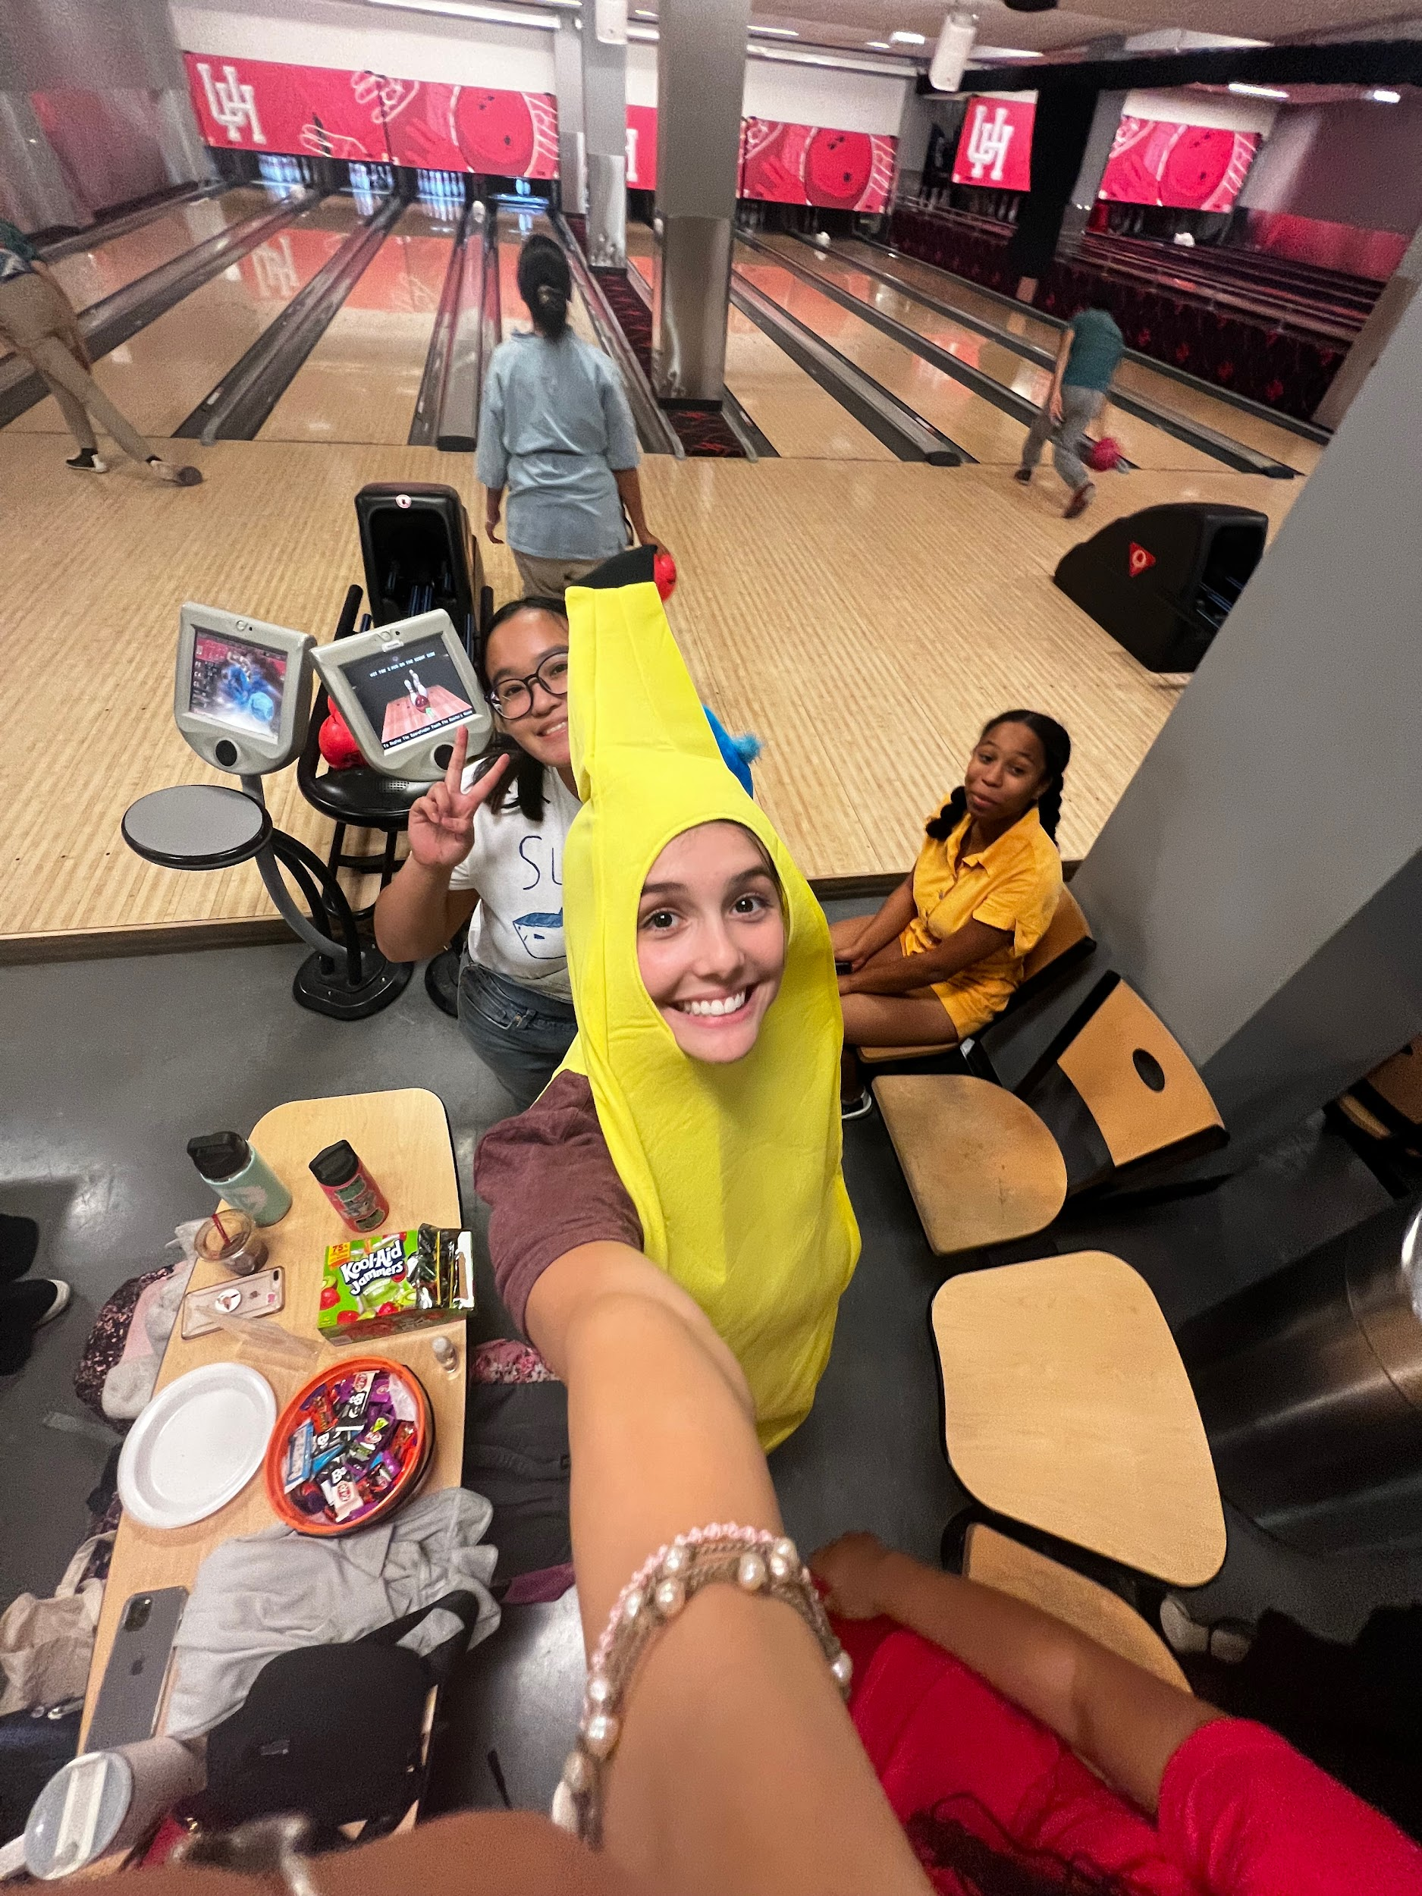

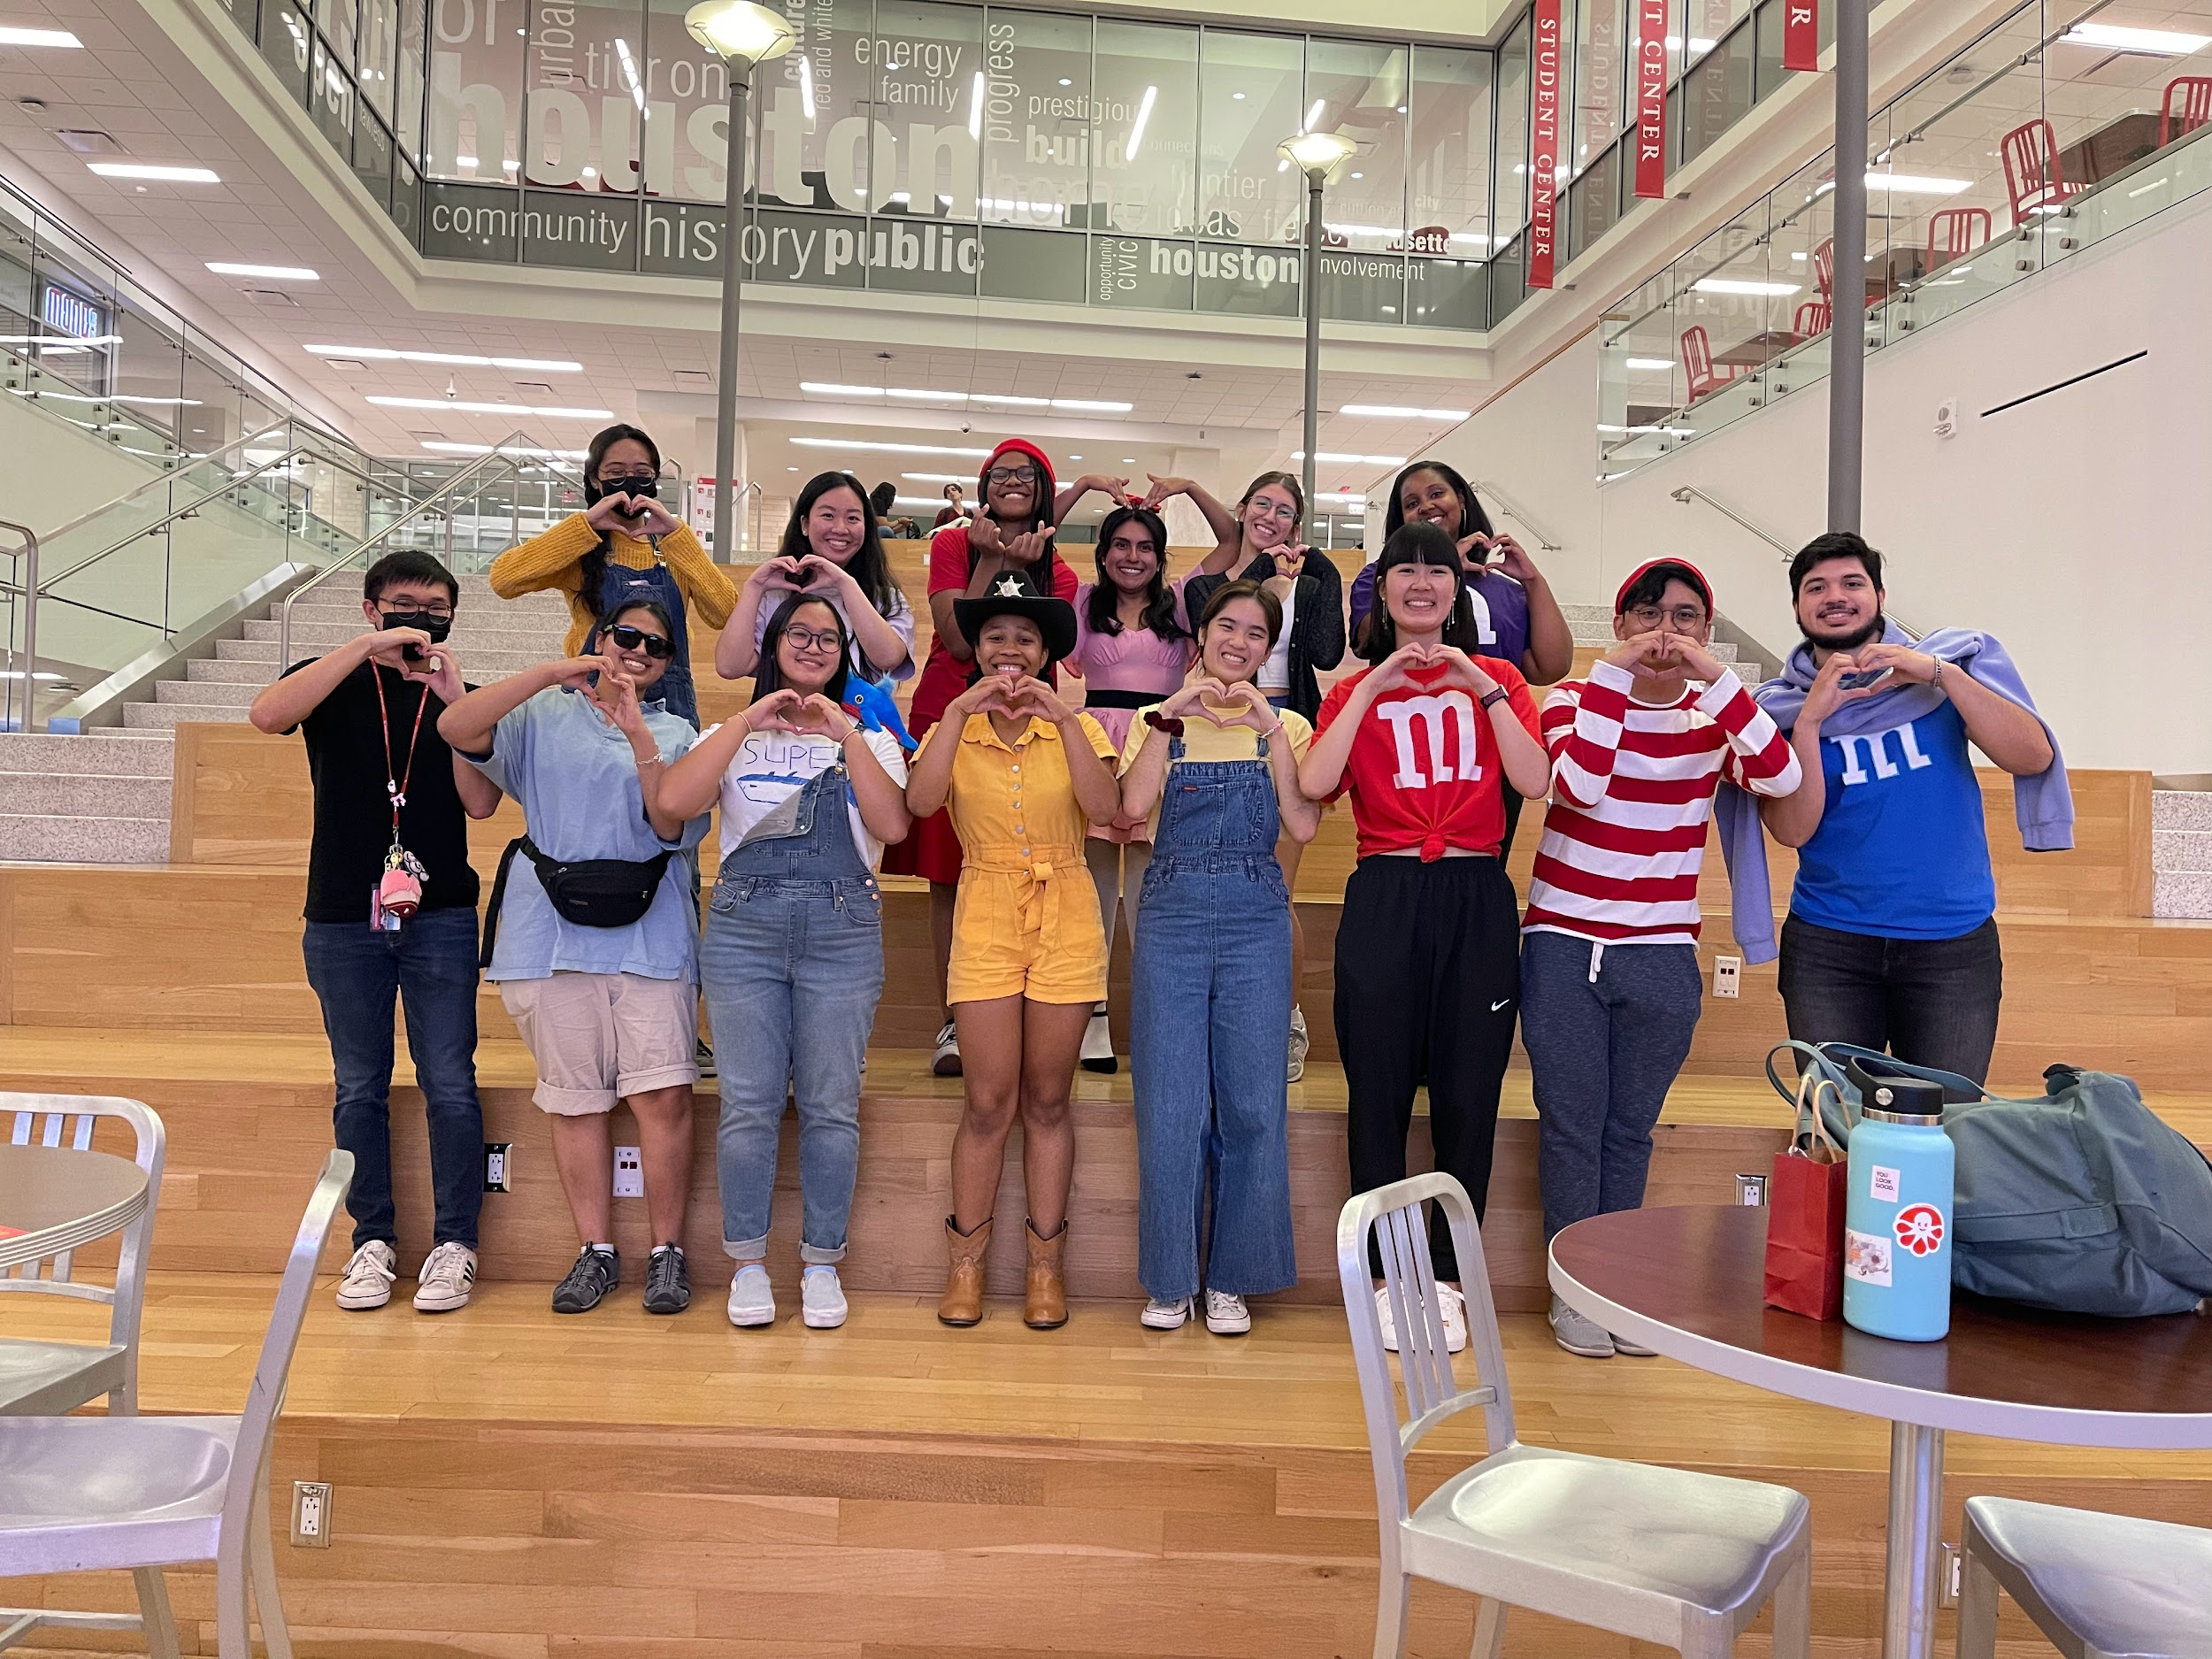
HALLOWEEN SOCIAL
  When: Tuesday, October 29th @ 6:30-8:30
  Where: Game room at Student Center South (next to Starbucks)
  What: Join us in our annual Halloween social! There will be costume contests, prizes, bowling, and pizza!!

Slide 14
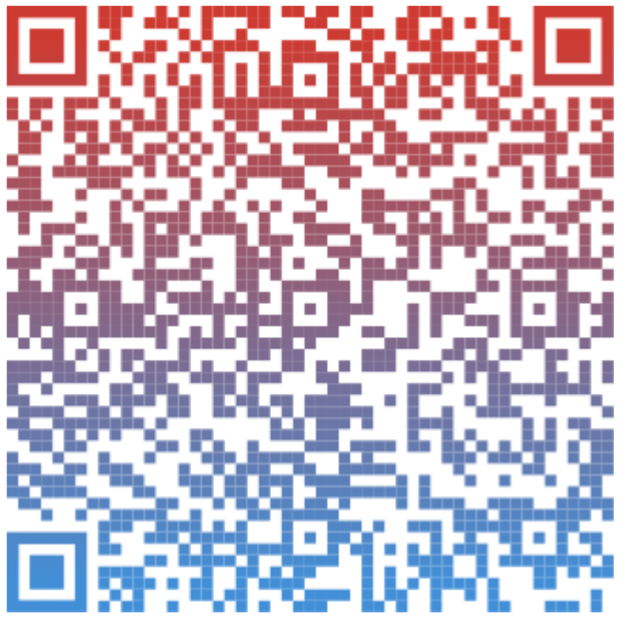

Game Night Social @ Cidercade!!
  When: Friday, September 27th @ 6:30
  Where: Cidercade
  What: Play tons of arcade games with other POPS members!! $12 = unlimited play on all games! 18+ after 9 PM.
Link to their website:
Link to sign-up:

Slide 15
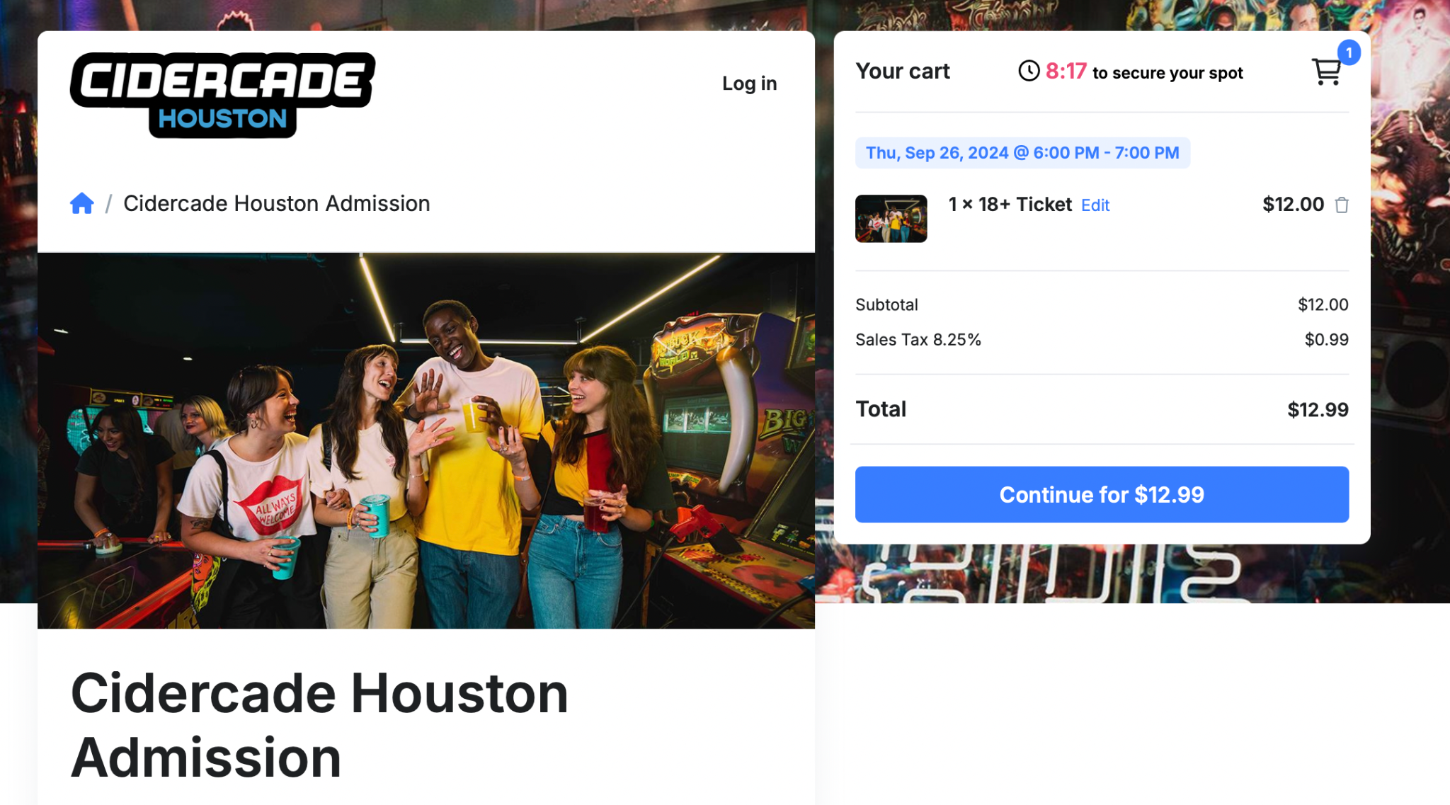


Slide 16

UHCO Info Session
When?
Tuesday, September 24th from 3PM to 4PM
Where?
UH Career Services in SSC1 at UHCO
About?
For undergraduate students interested in UHCO’s graduate programs of study
Answer any questions about the admissions process
Website?
Log into Access UH --> click on University Career Services (the icon says CougarPathway) --> search "Optometry" Log into
*Please email pictures for proof of attendance within 24 hours. *

Slide 17
Opportunity
  When
  Where
  What

Slide 18

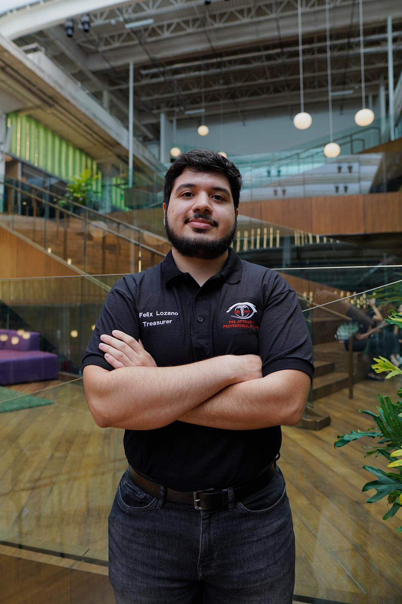
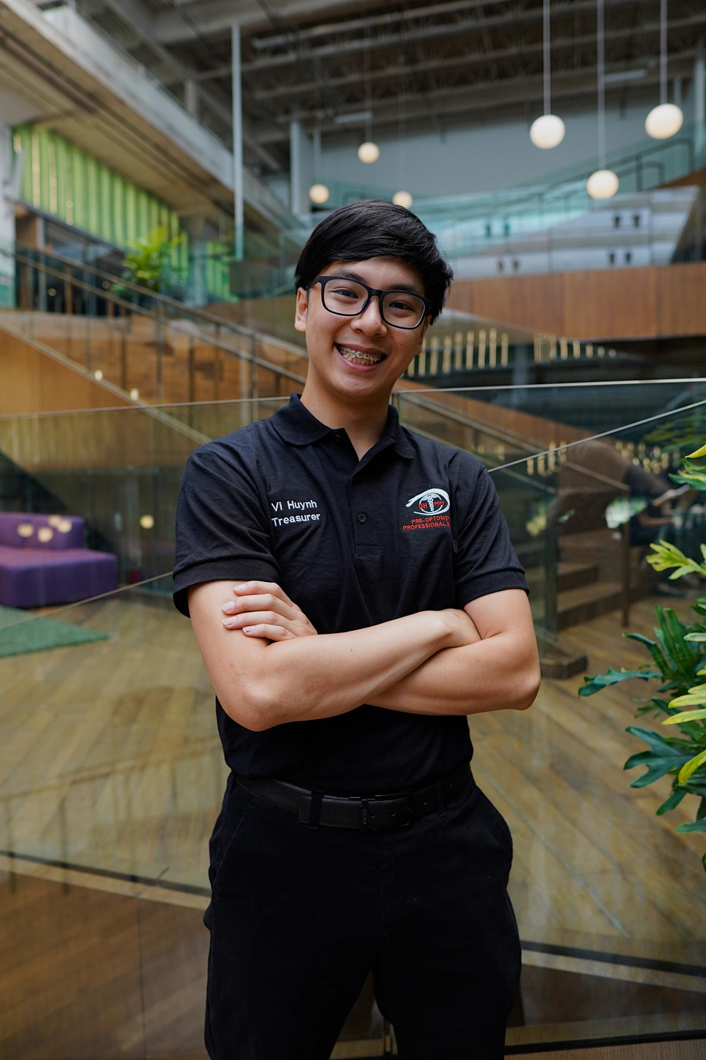
Treasurers
Felix Lozano and Vi Huynh
Email:
uhpops.treasury@gmail.com
Carrel Space:
SC North, Carrel 37
Office Hours:
Felix - Monday, 4:00PM - 5:00PM
Vi - Tuesday , 1:30PM - 2:30PM
Notes:
Mention email quickly and carrel hours.

Slide 19
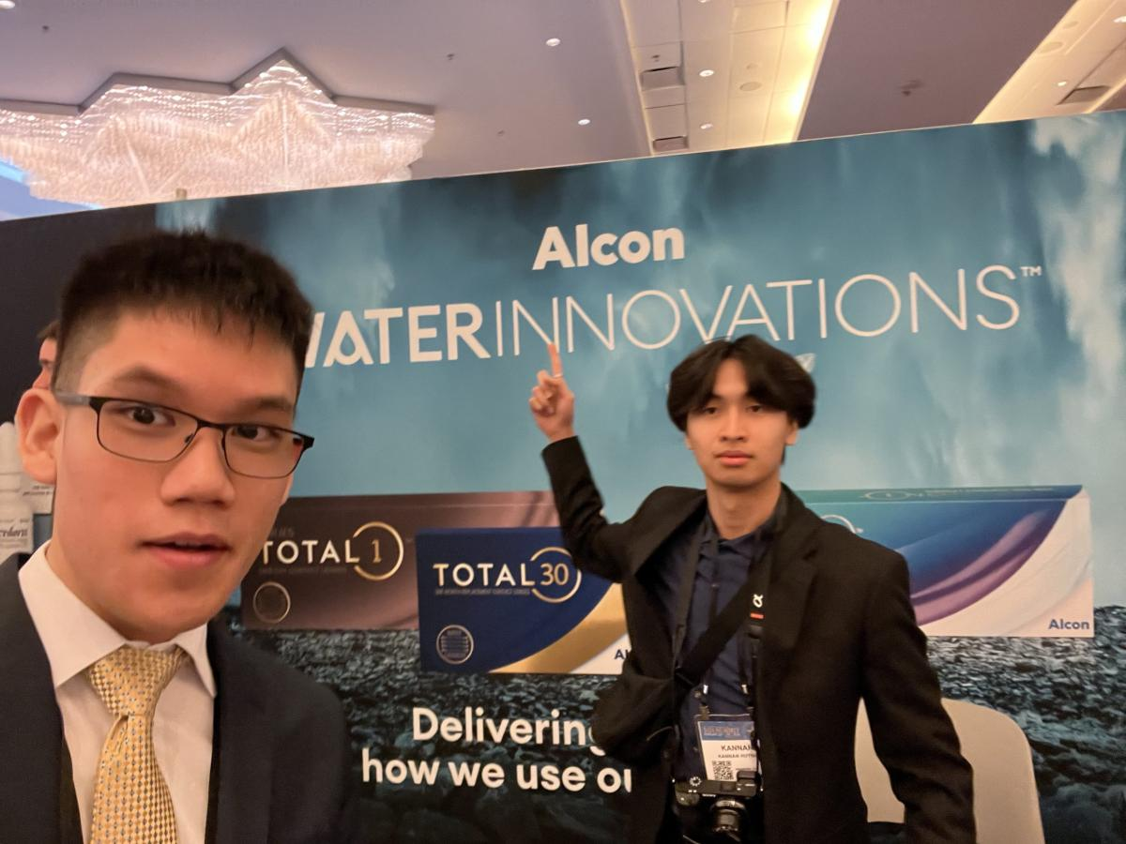
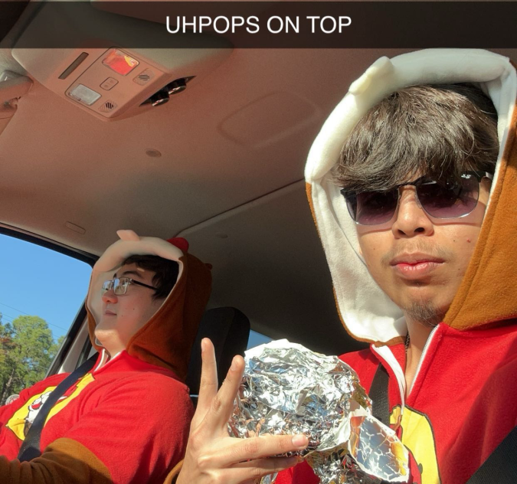
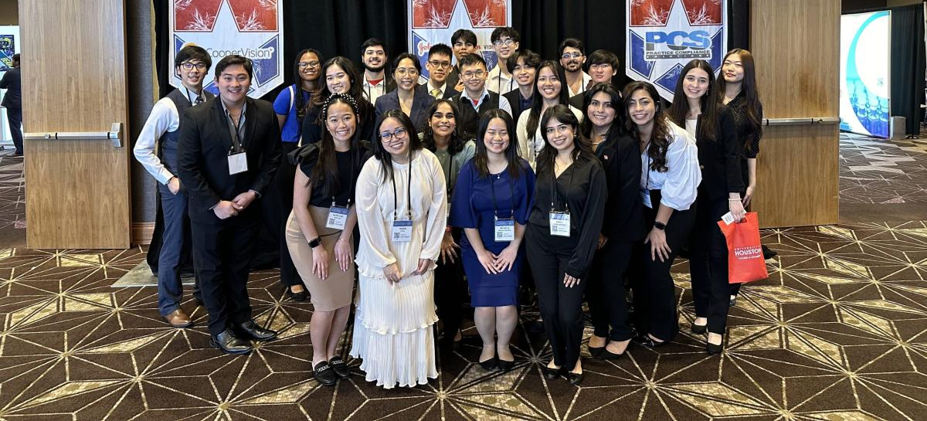
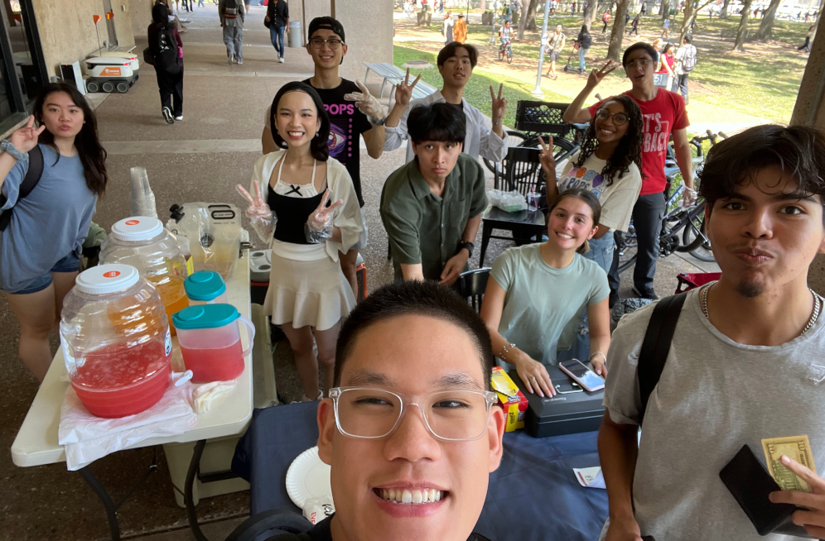
Duties
  Responsible for membership dues and forms
  Coordinate bake sales and bake nights
  Plan & Budget for Big Events like Banquet and TOA
  Please reach out to the treasury email if you have any questions or concerns at uhpops.treasury@gmail.com
T.O.A. in Austin
Bake Sales @ PGH
Notes:
20 seconds explanation through duties:
We manage the dues and forms, bake sales events, and planning for big events.

Slide 20
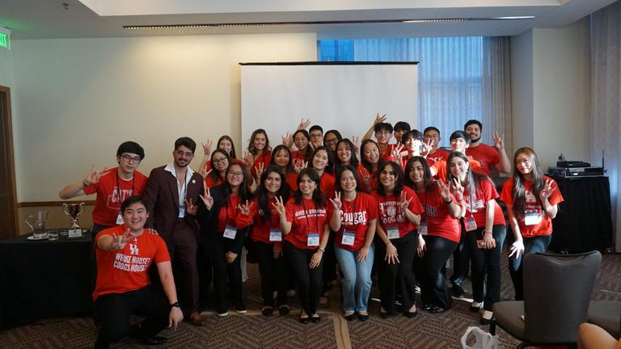

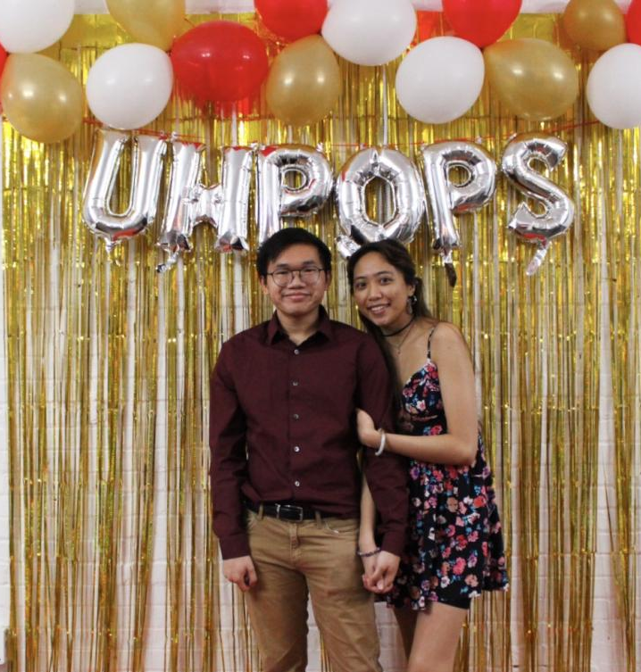


Membership Perks
  Scholarships
  Monthly Socials
  Texas Optometric Association Convention
  End of Year Banquet
  Bi-Weekly Meetings with Guest Speakers
  Discounted OAT Prep
  Optometry Job Opportunities
  Optometry School Admission Counselors
  Involve yourself in a community of friends and classmates
Notes:
Here’s some quick perks, scholarships, “fun event in austin”, Discounted OAT Prep, job portal

Slide 21


T-SHIRTS!!!!!
  T-shirts are available for pickup!!!
  Stay around after the meeting to pick up
  You can pick up T-shirts by scheduling with us or during our office hours if unable to pick up at GM’s.
Carrel Space:
SC North, Carrel 37
Office Hours:
Felix - Monday, 4:00PM - 5:00PM
Vi - Tuesday , 1:30PM - 2:30PM
Notes:
Mention email quickly and carrel hours.

Slide 22
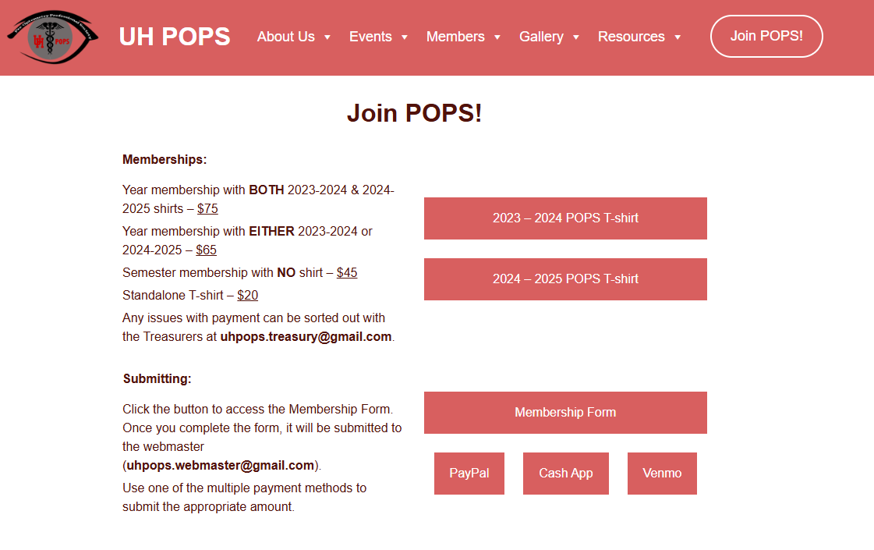



Memberships FAQ
uhpops.org
  How Do I Join?
    Head to our website uhpops.org and click “Join POPS!” on the top right of the screen. Fill out the membership form then pay the dues to become a member!
If paying with cash or card, please visit during carrel hours or schedule!
    Deadline - Today @ 11:59 PM!
    To become a full member:
      You must submit the form AND pay the dues:
        Your name will be present on the points tab on the website
  T-Shirt Pickup
    T-Shirts are handed out after the meeting (Available 3rd GM)
    Alternatives:
      Carrel hours (must email prior to coming!)
1
2
Cash or Card?
Come talk to us!
email uhpops.treasury@gmail.com for further inquiries
Notes:
Memberships:
If you have not applied, visit uhpops.org and click “join pops” and you will see all the relevant information for full memberships. Deadline is October 9, which is our 3rd GM. T-shirts will be available during the 3rd GM

Slide 23

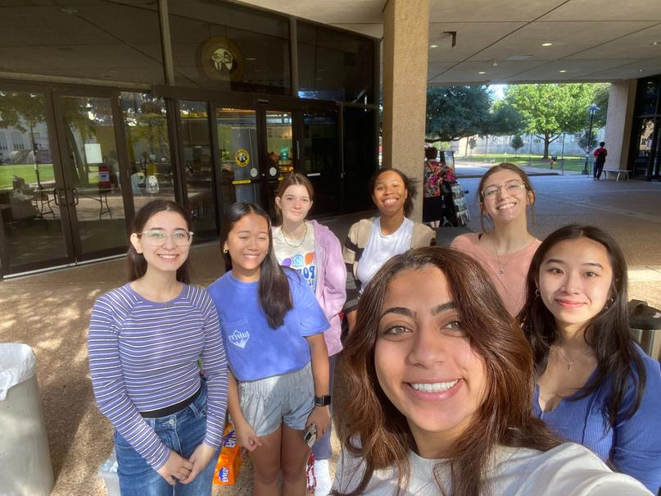

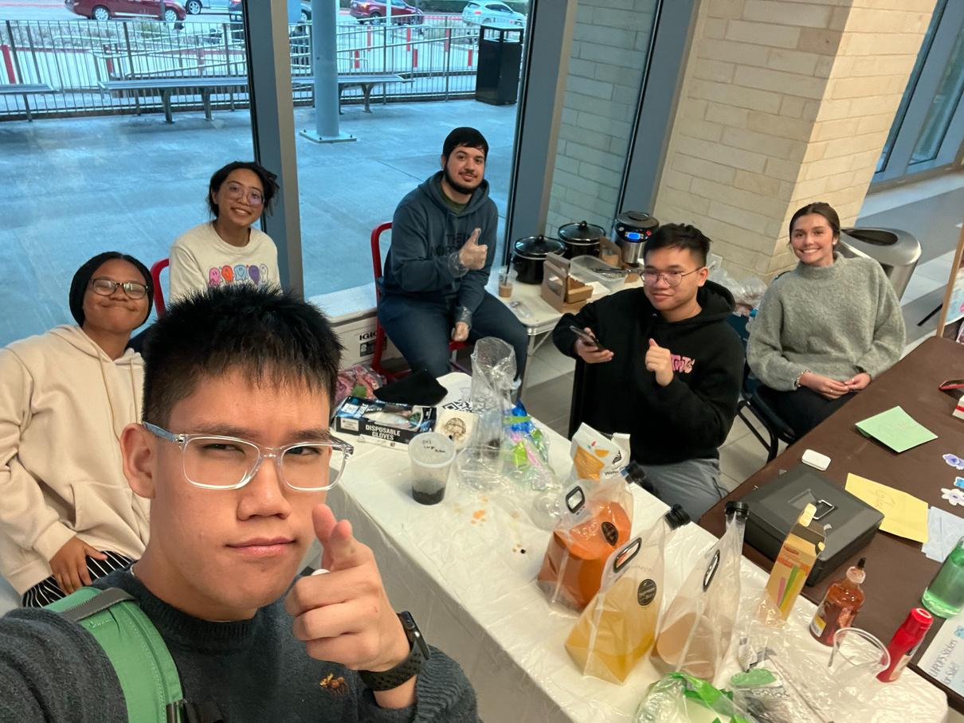

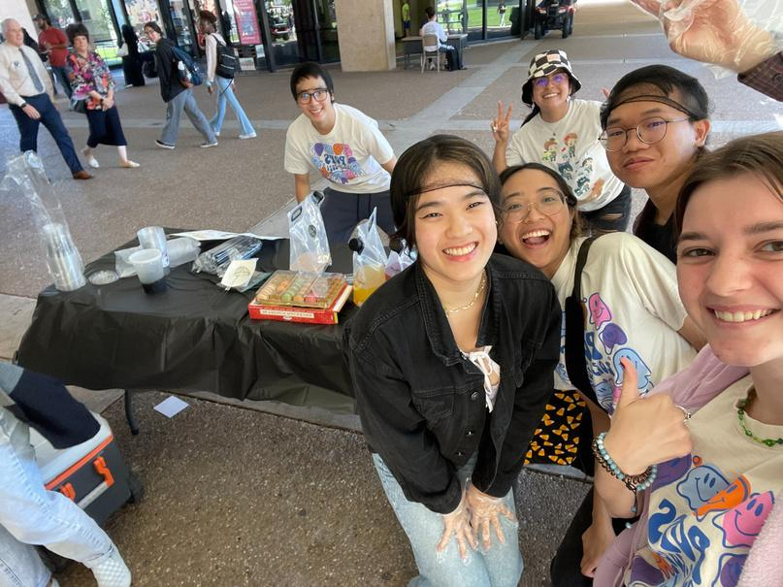

Bake Sale
  When: October 9th, 2024
  Volunteers NEEDED
    Sign up will be posted!
    Shifts from 10:30AM-4:30PM
  Bake Night!
    October 8th, 2024 @ 5:30pm
    Sign up will be posted!
    Come out to prepare for our second bake sale!
      We will be drawing, decorating the menu, and hanging out
email uhpops.treasurey@gmail.com for further inquiries
Notes:
Forget about what we said last week, we are going back to the regular and doing bake nights! It’ll be a night for getting ready for the bake sale the next day!

Slide 24
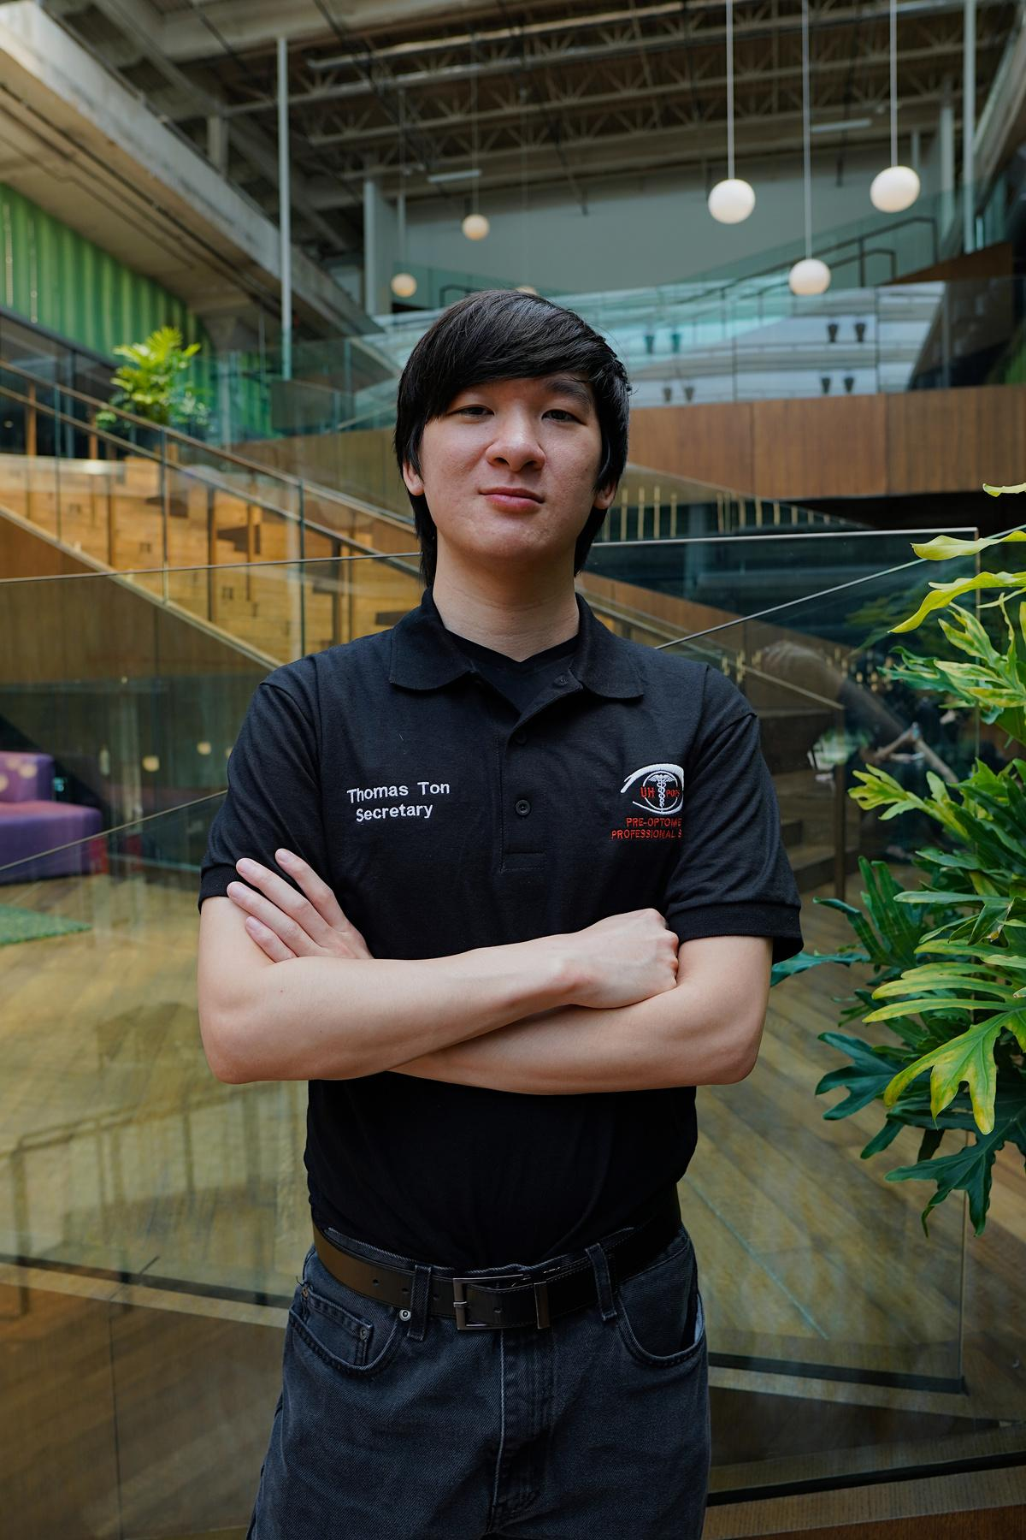
Secretary
Thomas Ton
Email:
uhpops.secretary@gmail.com
Carrel Space:
SC North, Carrel 37
Office Hours:
Wednesday, 4:30PM - 5:30PM

Slide 25



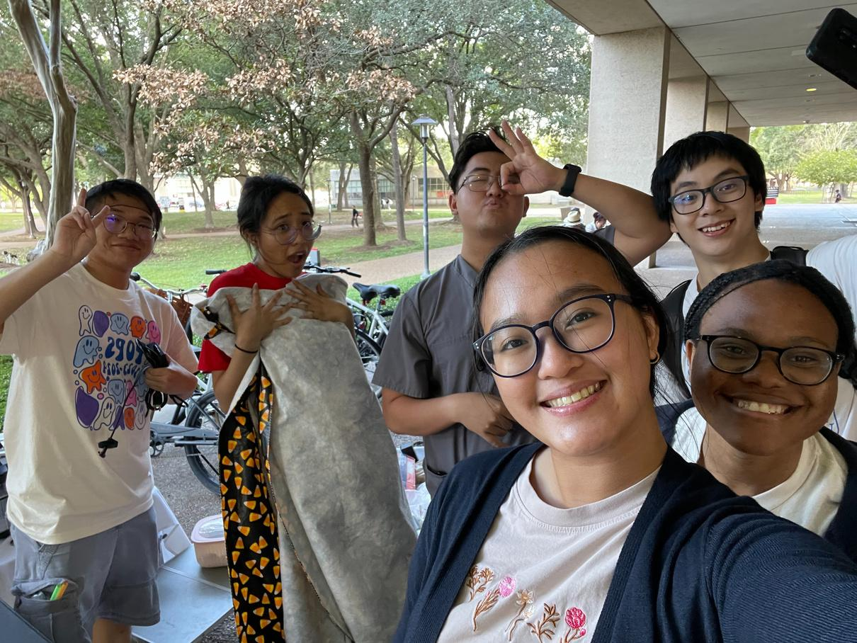
Duties
  Manage Points
    Points will be updated on our website every Friday.
  Manage the Class Registry
    All members will have access to the Fall 2024 class registry. Put your name down and find your next study buddy!
  Award Member of the Month
    The most active member of each month will be awarded with a graduation cord.
  Manage OAT Bank
    You can donate or request physical and digital materials to study for the OAT!
    To checkout study materials, please email uhpops.secretary@gmail.com

Slide 26
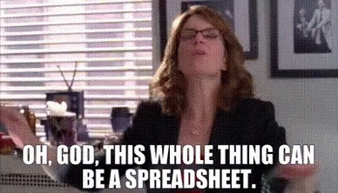
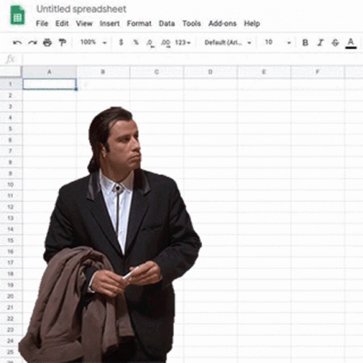
Duties
  Manage Points
    Points will be updated on our website every Friday.
  Manage the Class Registry
    All members will have access to the Fall 2024 class registry. Put your name down and find your next study buddy!
  Award Member of the Month
    The most active member of each month will be awarded with a graduation cord.
Notes:
Duties Slide Without OAT Bank

Slide 27
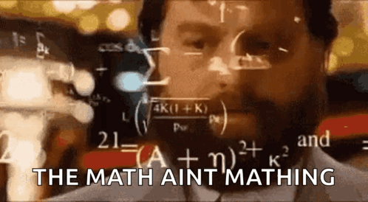

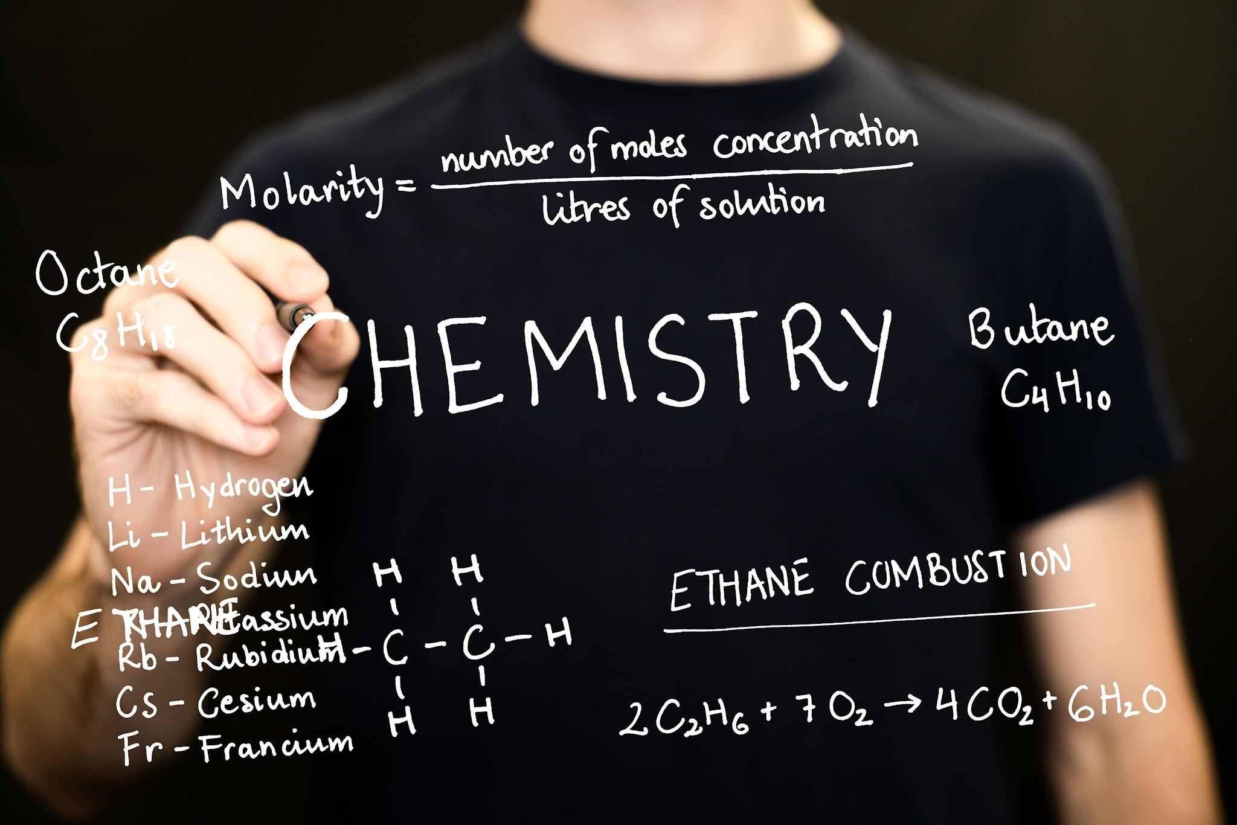

Class Registry
  All paid members will have access to the Fall 2024 class registry.
  See other POPS members that are taking your class and become study buddies!
  This form does contain sensitive information, such as names and email addresses, so please do not share the form with nonmembers!
  Please email uhpops.secretary@gmail.com for additional information

Slide 28
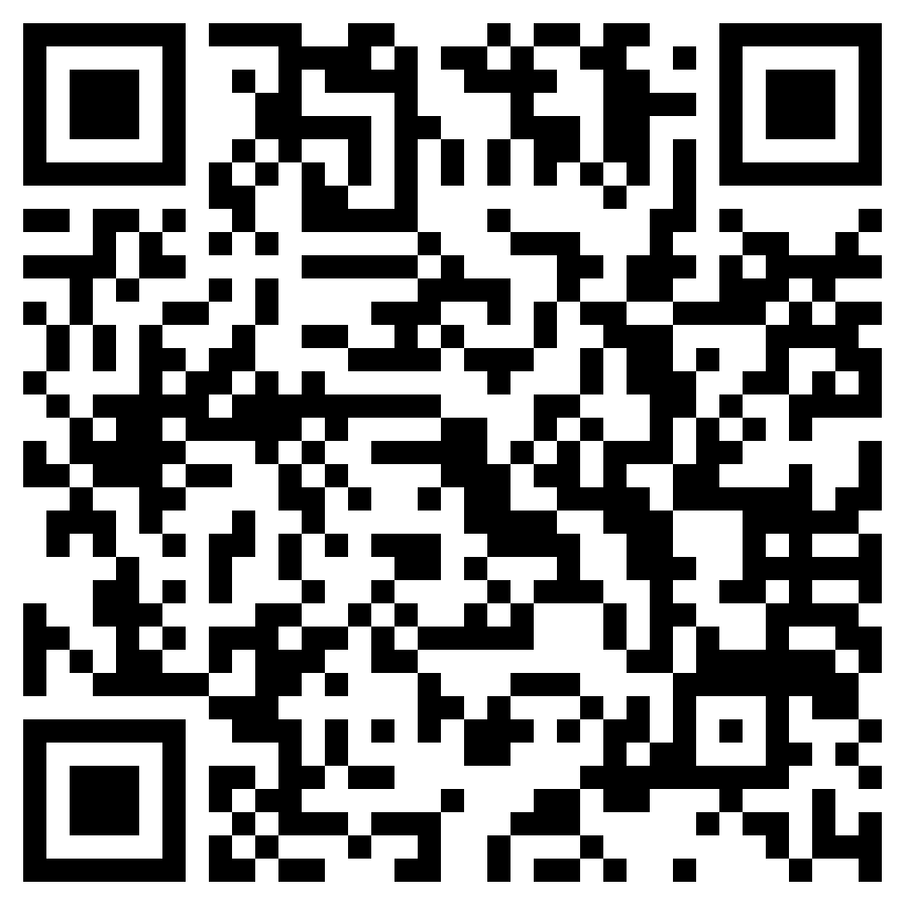
OAT Materials
  Information about OAT materials here
  Email uhpops.secretary@gmail.com for additional information
  Scan the QR code to access the OAT Physical Book Request Form:

Slide 29

How to Earn Points
Distinguished (130+ points)
Eligible for:
        TOA
        Spring Conference
        End of the Year Banquet
        Office
        Scholarship
Honorable (100+ points)
Eligible for:
        TOA
        Spring Conference
        End of the Year Banquet
        Office
Active (70+ points)
Eligible for:
        TOA
        Spring Conference
  VOLUNTEER
    Attend Socials & Workshops
    Attend Meetings
    Intramural Sports
    Frame Donations
    Sponsorships
    Pictures
    Office Hours Bingo Sheet

Slide 30
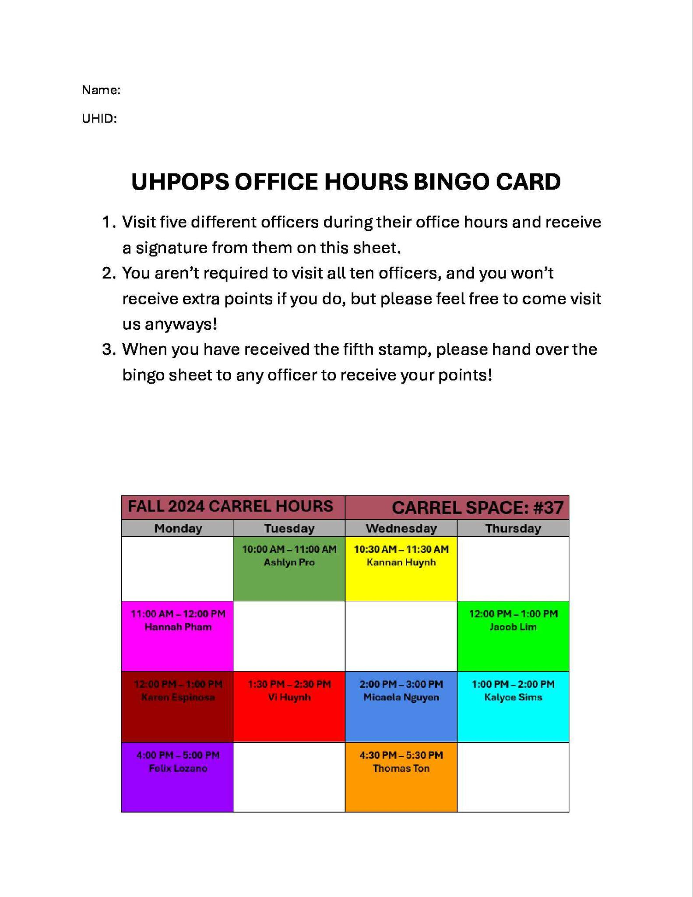
Office Hours Bingo Sheet
  Instructions
    Visit any five officers during their office hours
    Receive a signature from the officer
    When you have collected five signatures, turn in the bingo sheet to any officer to receive points!
* visiting more than five officers isn’t required and
won’t grant extra points
* bingo sheet can only be used once per year

Slide 31


Join Remind
  Join our Remind group to receive updates on job opportunities, socials, volunteering events, and more!
  TEXT @uhpops to the number 81010
    You’ll receive a welcome text from Remind
  If 81010 does not work for you, try texting @uhpops to (682)-888-5131
To: 81010
@uhpops

Slide 32
Congratulations To The October Member Of The Month:

Slide 33
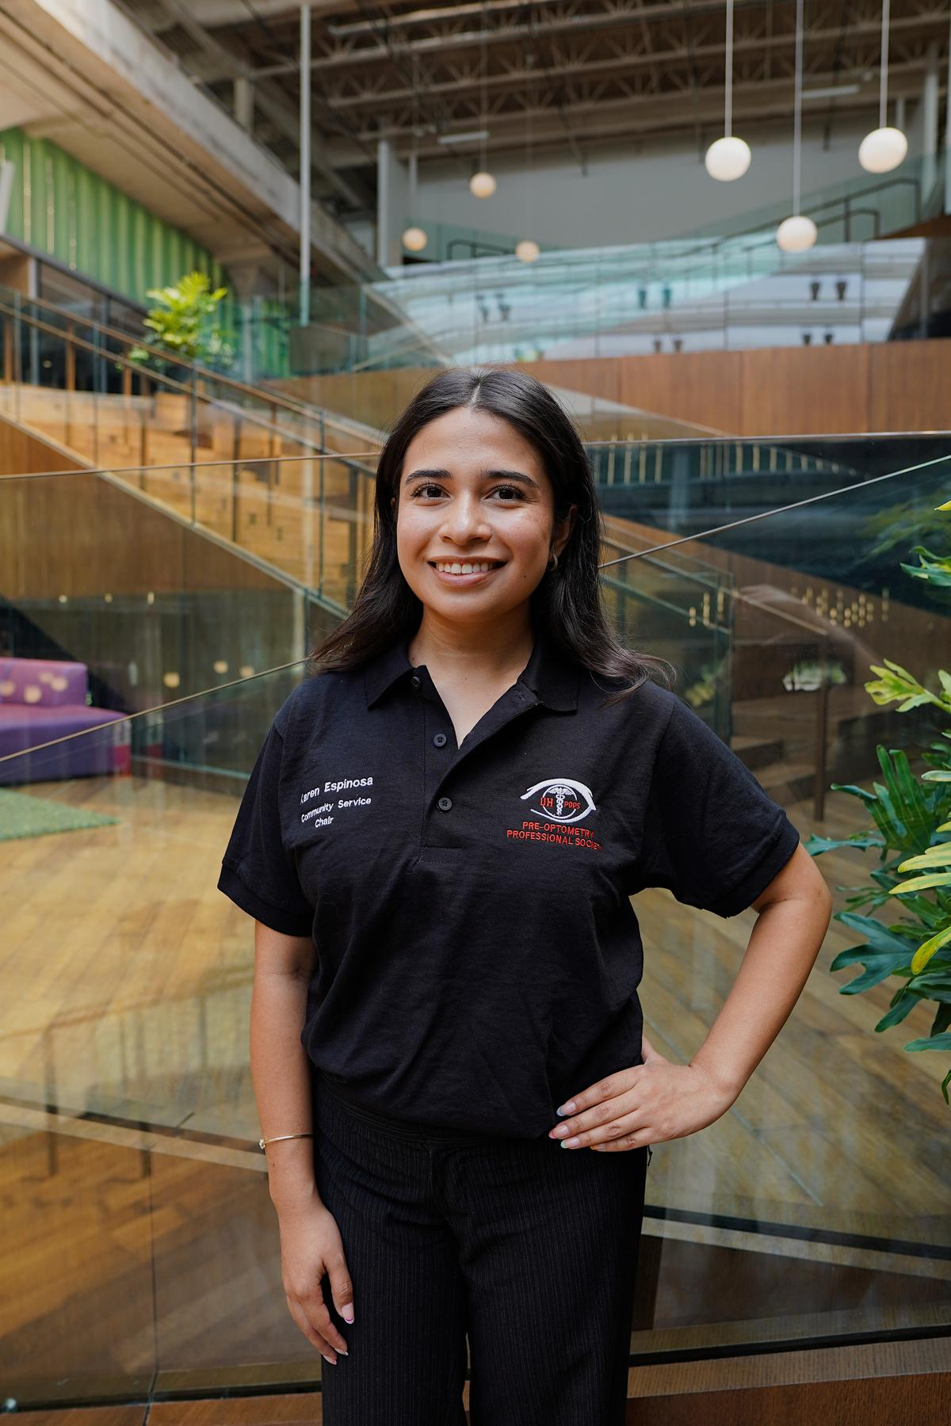
Community Service Chair
Karen Espinosa
Email:
uhpops.volunteer@gmail.com
Carrel Space:
SC North, Carrel 37
Office Hours:
Monday, 12:00PM - 1:00PM

Slide 34
Duties
  Organize volunteer events
  Submit event details to the Webmaster and Historian
  Ensure communication with event coordinators
  Coordinate with Prevent Blindness Texas for PBT Internships
  Manage the uhpops.volunteer@gmail.com

Slide 35
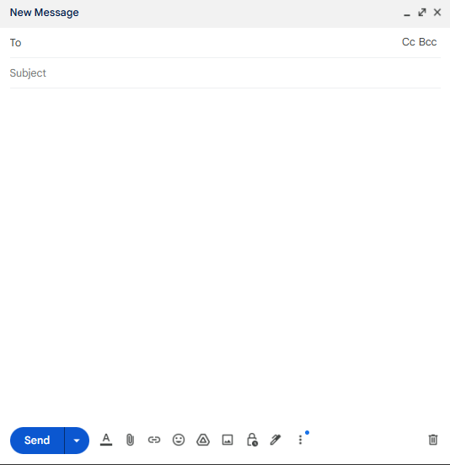
Community Service Chair
Volunteer Opportunities
BEST WAY TO EARN POINTS!
All opportunities can be found in our facebook group or on our website
    In Person Events
    Virtual Workshops
How to receive points for volunteer hours
Email attendance photo + hours to uhpops.volunteer@gmail.com
Email must be sent within 24 hours of volunteer event
Cancellation Policy
48 hour notice. Failure to contact CSC for cancellation will result in point deduction.
uhpops.volunteer@gmail.com
Volunteer Attendance
Name:
Date volunteered:
Volunteer event attended:
Hours:
**attach photo**

Slide 36
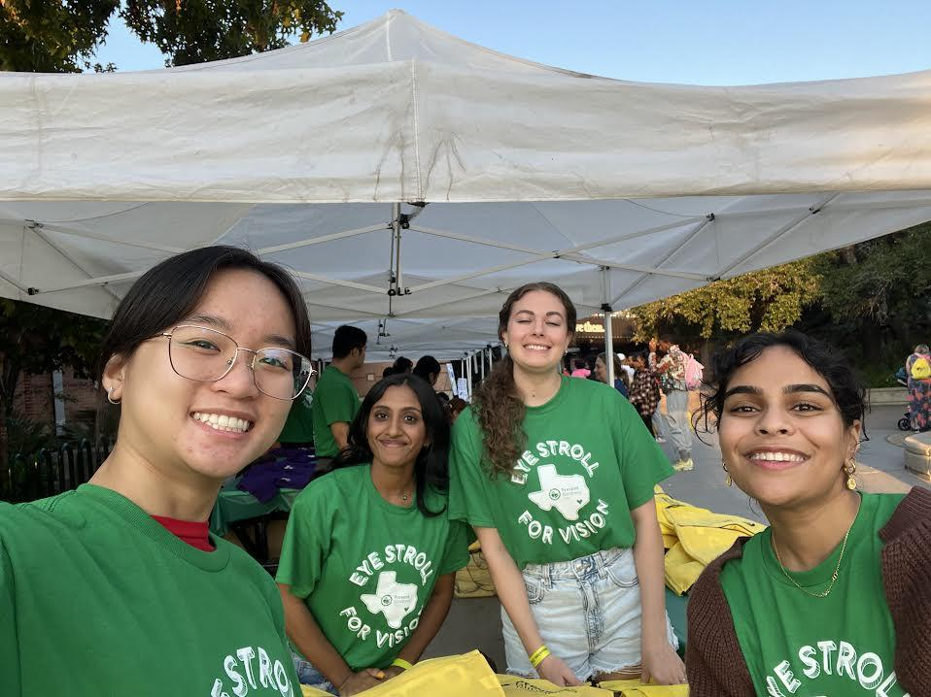
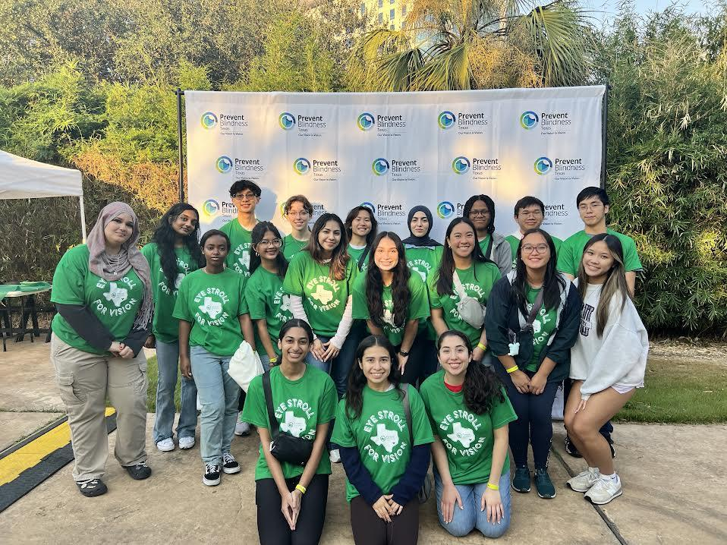
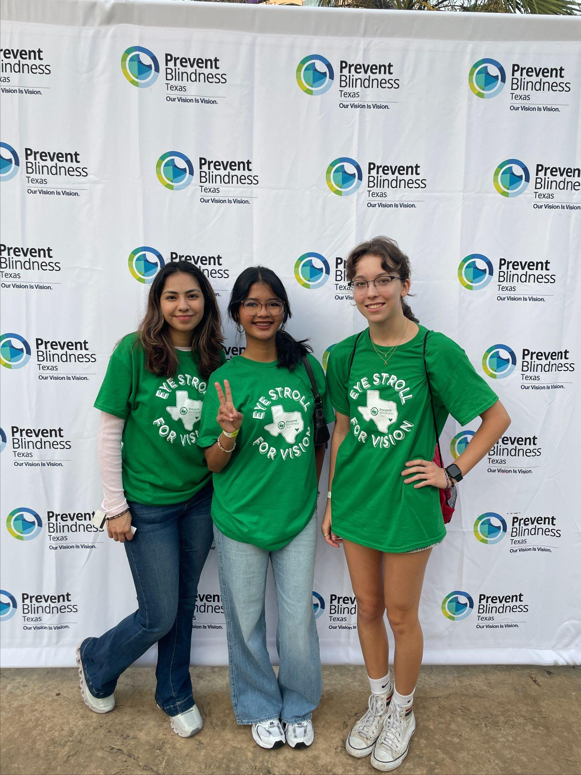
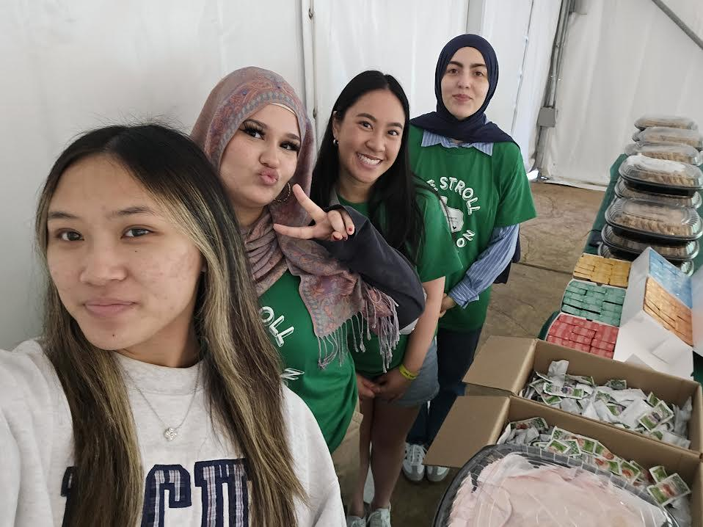
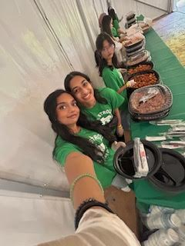
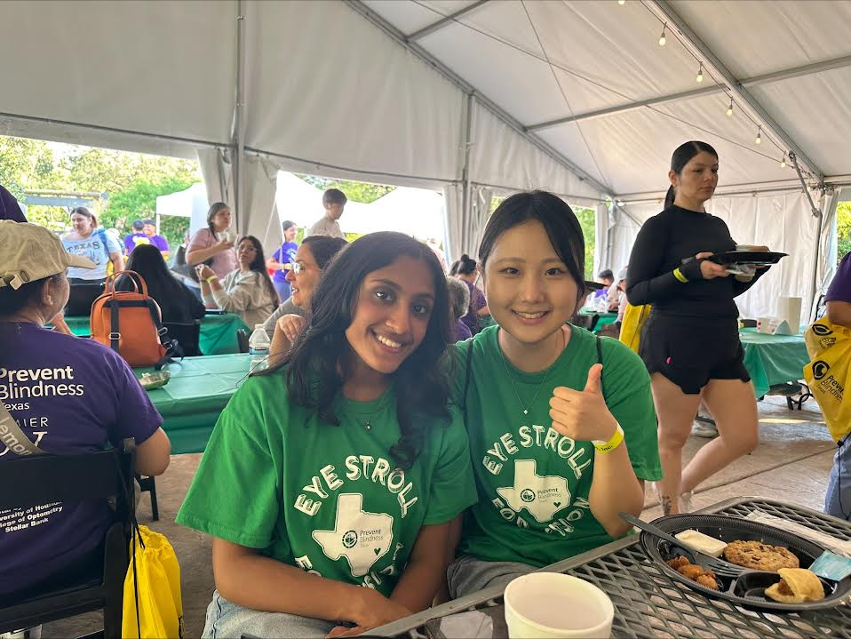
THANK YOU!

Slide 37


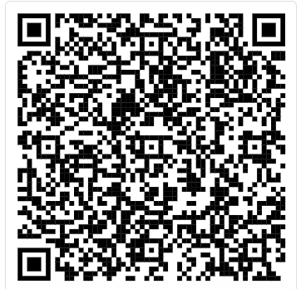
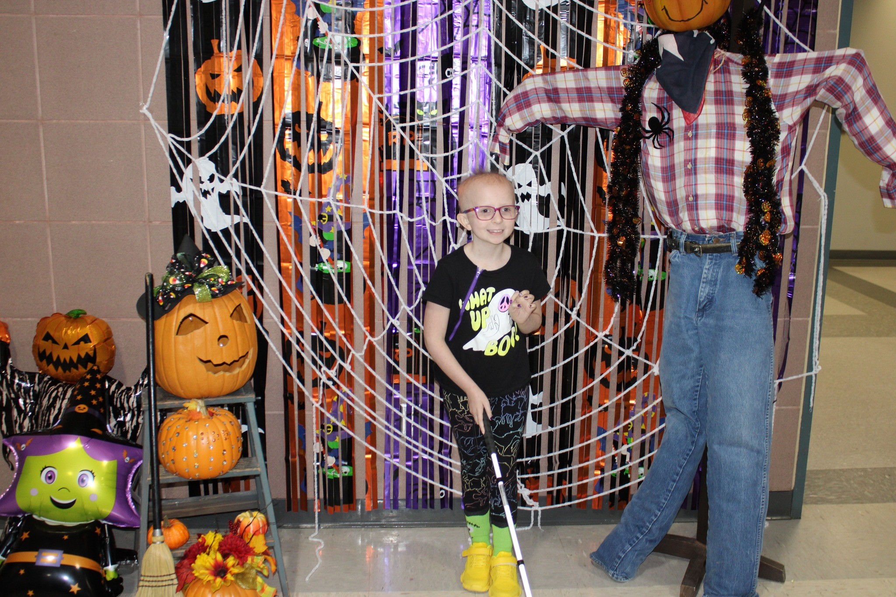
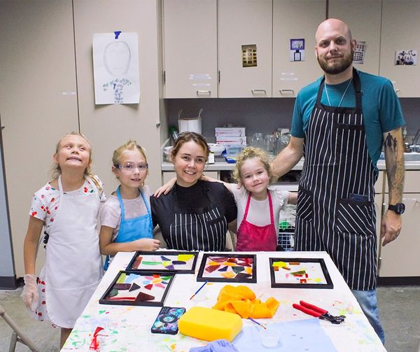
Upcoming Volunteer Events
Lighthouse of Houston - Youth Halloween Carnival
When: Saturday, October 26th 2024 10am-1pm
Where: The Lighthouse of Houston
3602 West Dallas
Houston, TX 77019 United States
Volunteers will help manage 25 activity booths
*Please look for email following registration for waiver and volunteer form*

Slide 38
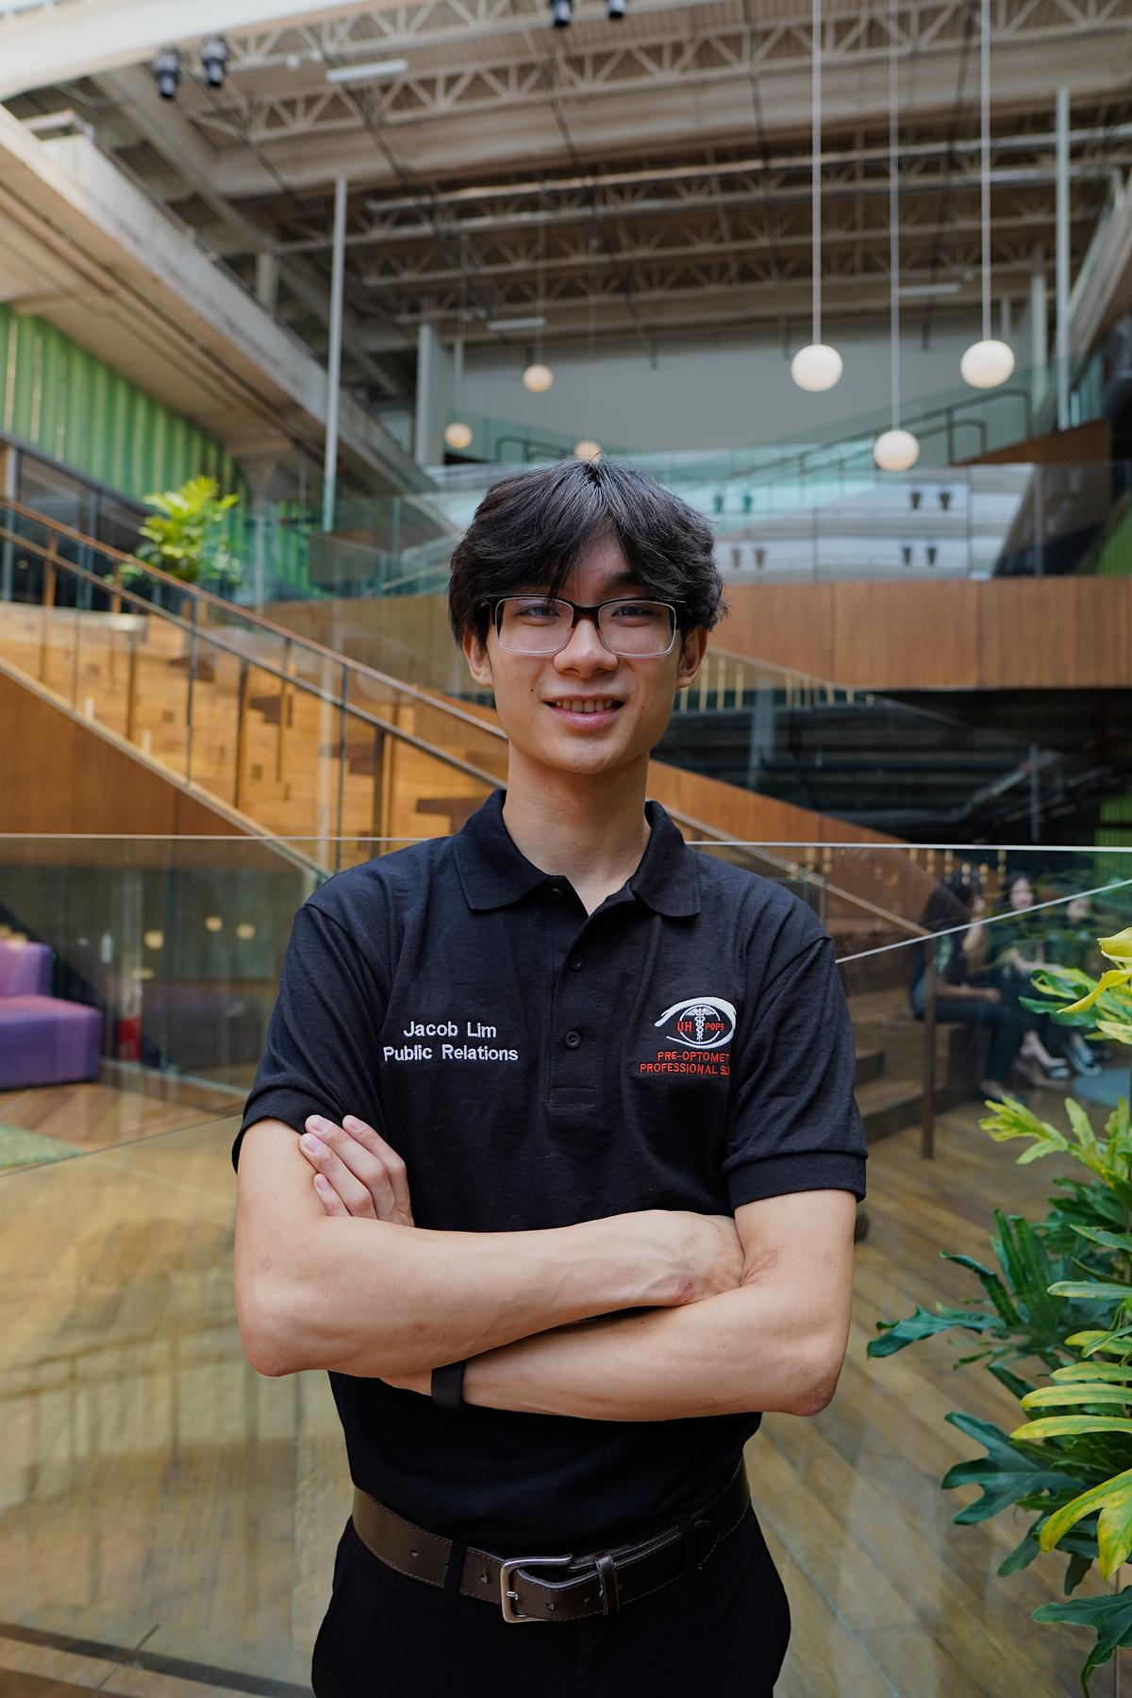
Internal Relations
Jacob Lim
Email:
uhpops.ir@gmail.com
Carrel Space:
SC North, Carrel 37
Office Hours:
Thursday, 12:00PM - 1:00PM

Slide 39
Duties
  Assist Vice President with planning socials
  Assist Public Relations with sponsors
  Plan End of the Year Banquet with Public Relations Chair and Historian
  Recruiting new members through advertising
  Organize intramural sports
  Manage POPS families
    Please reach out to the IR Chair if you have any questions or concerns at uhpops.ir@gmail.com

Slide 40
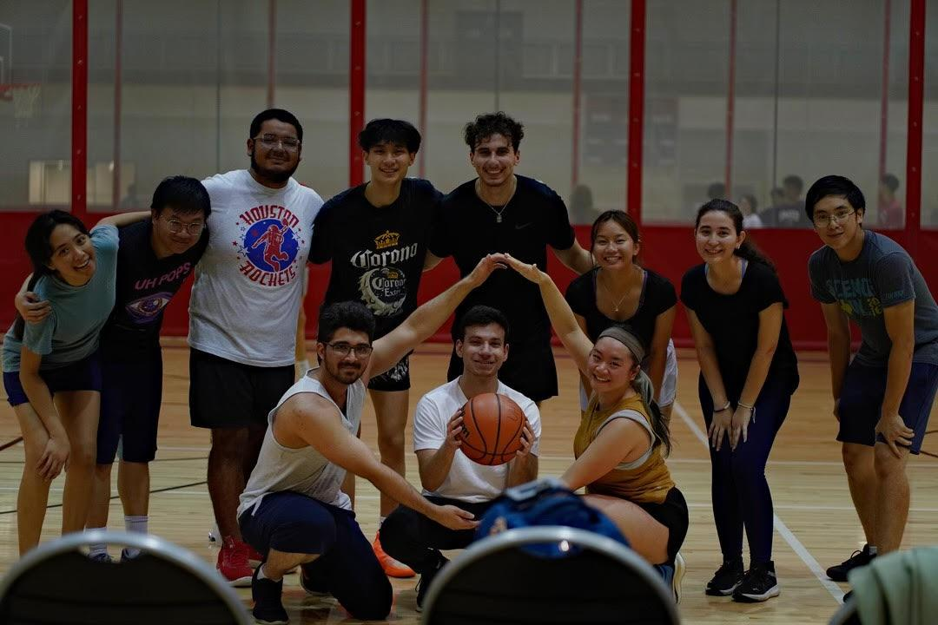
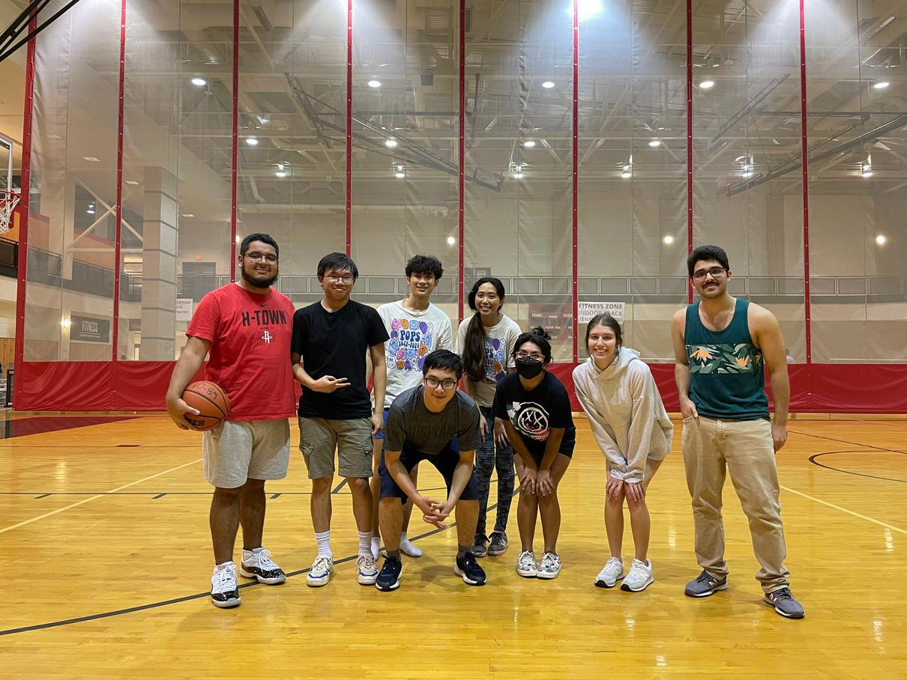
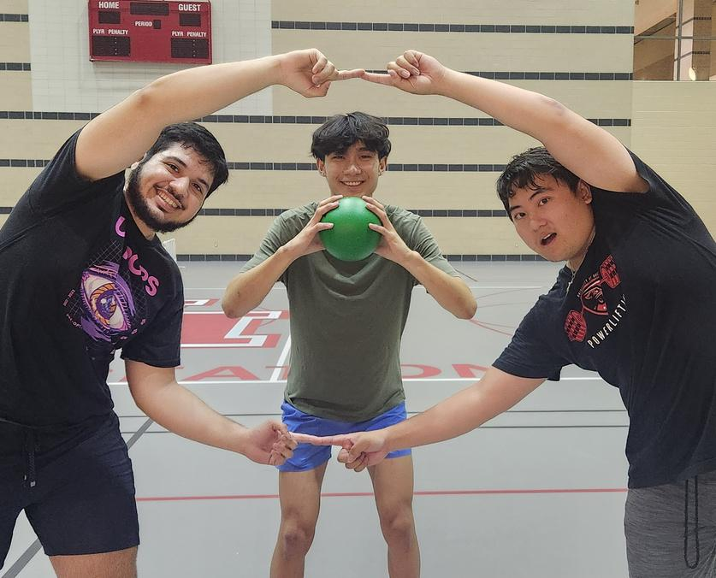

Intramural Sports
  EYEBALLERS!
  Come Watch Our Team Play
    Fall Basketball Schedule
      10/15: 10pm vs Migoats
      10/22: 10pm vs Rush Hour
      10/29: 10pm vs NGSB
      11/5: 10pm vs Beta Alpha Pie
      11/12: 9pm vs Moody Munchers

Slide 41
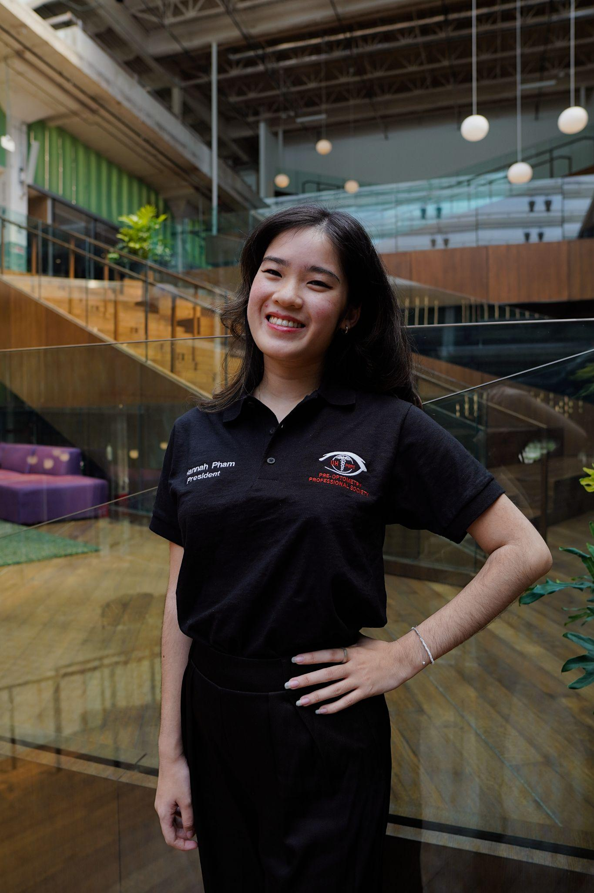










Glockoma:
Hannah Pham, Felix Lozano, Kannan Huynh Micaela Nguyen
POPS Families
Visionaries:
Ashlyn Pro, Karen Espinosa, Jacob Lim
Retinopaths:
Vi Huynh, Thomas Ton, Kalyce Sims

Slide 42

POPS Families
If you haven’t been placed in a Family FILL OUT THE FORM!
Stay after to meet your Officers and people in your Fam!
Thank you again to everyone who filled out the form.

Slide 43

Public Relations
Micaela Nguyen
Email:
uhpops.pr@gmail.com
Carrel Space:
SC North, Carrel 37
Office Hours:
Wednesday, 2:00PM- 3:00PM

Slide 44

Duties
  Sponsors
UH POPS would not be the great organization it is without our sponsors!
  Discount Codes
Email uhpops.pr@gmail.com for discount codes on OAT test prep materials and scrubs! For paid members only.
  Fundraising
  Assist Internal Relations with member involvement
  Plan End of the Year Banquet with Internal Relations and Historian

Slide 45

Profit Share at Teapresso Bar
Come out to Teapresso Bar Eado to support UH POPS and meet your new families!
When? Thursday, October 24th 10AM-9PM
- Family Meet & Greet @6:30
Where? 2929 Navigation Blvd, Houston, TX, 77003
*Remember to mention UH POPS when ordering*

Slide 46

Profit Share at MOD Pizza
Come out to MOD Pizza to support UH POPS!
When? Thursday, November 14th 10:30AM-10PM
Where? 920 Gulfgate Center Mall,
Houston, TX, 77087
*Remember to show this flyer or use code when ordering*

Slide 47

Counseling and Psychological Services (CAPS)
College can be overwhelming…
Thankfully, UH provides resources to help support us.
Located at
4349 Martin Luther King Blvd., Health 2 Building,
Rm. 2005 Houston, TX 77204
Crisis Support Contact: 713-743-5454 or 988
Website: https://www.uh.edu/caps/

Slide 48








Thank You to Our Sponsors!

Slide 49

Historian
Kannan Huynh
Email:
uhpops.historian@gmail.com
Carrel Space:
SC North, Carrel 37
Office Hours:
Wednesday, 10:30AM - 11:30AM

Slide 50

Duties
  Document and take photos and videos for events, meetings, trips, and more.
  Maintain social media.
  Plan End of the Year Banquet with Internal Relations and Public Relations chairs.

Slide 51



How to Earn Points
  For photo points: email uhpops.historian@gmail.com
    You MUST Cc uhpops.volunteer@gmail.com
      This is so our Community Service Chair can record your hours for volunteering events.
Must be sent 24 hrs of the event (1 warning after 24 hrs)
Make sure they are unique!

Slide 52
Email Format
Template
uhpops.historian@gmail.com, uhpops.volunteer@gmail.com
  Enter your full name
  Event name and date
  Attach your own unique photos and videos
  You MUST Cc uhpops.volunteer@gmail.com
POPS Event Photo
Your Name
Pops Event
Date of Event
Hours
you can click on either of these buttons to attach photos/videos

Slide 53

Test Prep Tuesday Answers
  10/1:
Solution:
Total Mass: 2 + 4 + 6 = 12 kg
F = ma
20 = 12a
1.7 m/s^2 = a
Contact Force Between 4 kg and 6 kg:
F = ma
F = (6)(1.7)
F = 10.2 N

Slide 54

Test Prep Tuesday Answers
  10/15:
Solution:
B
Carbanion stability is opposite that of carbocation stability. For carbanions: methyl > 1°> 2° > 3°. Choice C is a 1° carbanion, hence the most stable.
[Alkyl groups donate electrons, hence 3° would have 3 groups donating electrons; this would increase the negative charge and destabilize the specie].

Slide 55

Test Prep Tuesday
  Starting October 1st, there will be practice questions posted every two weeks until November 5th.
  These questions will be answered on a google form.
Google form will be accessible through:
Instagram
Linktr.ee
  Answers will be announced at General Meetings!

Slide 56



Social Media
Linktr.ee
  Linktr.ee
    You can scan the QR code or head to linktr.ee/uhpops
  Connect with us on Instagram and Facebook
    IG: @uh_pops
    FB: UHPOPS

Slide 57

Webmaster
Kalyce Sims
Email:
uhpops.webmaster@gmail.com
Carrel Space:
SC North, Carrel 37
Office Hours:
Thursday, 1:00PM - 2:00PM

Slide 58
Duties
  Design a user-friendly website
  Update the website consistently
  In charge of the annual t-shirt design competition
  Communicate with the Historian to post on social media

Slide 59
Our Website
  Job Opportunities
  Upcoming Events on Homepage
    Links posted on the Events calendar
  Update Member Points
    Every Friday night
  Application Forms
    Membership form and Family form under the “Join POPS” tab
  Missed a Meeting/Workshop?
    Slides can be found under the “Meetings” tab
  Optometry Info

Slide 60
Optometry School Matriculants Spreadsheet
  Paid members will have access to past GPAs, OAT scores, etc.
  Gain insight into application process
  Help members identify target schools

Slide 61

Guest Speaker
Dr. Moore, Therapeutic Optometrist, FOVDR, Diplomate, ABO

